Slide 1
1
Introductory Concepts

Slide 2
Introductory Concepts

Slide 3
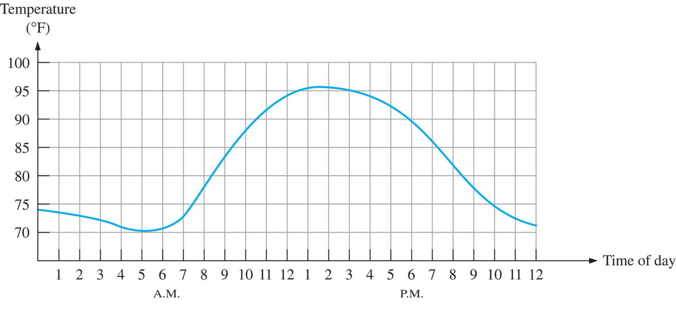
FIGURE 1-1 Graph of an analog quantity (temperature versus time).

Slide 4
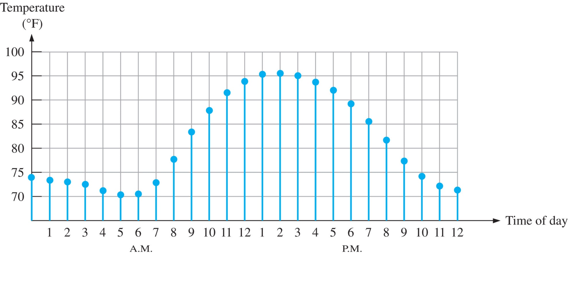
FIGURE 1-2 Sampled-value representation (quantization) of the analog quantity in Figure 1–1. Each value represented by a dot can be digitized by representing it as a digital code that consists of a series of 1s and 0s.

Slide 5
Introduction
Digital circuits, processing discrete information, are found in an astonishingly wide rang of electronic systems. They have provided system designers with more functions contained in less space, thereby improving system reliability and increasing speed. Digital systems operate on numbers that represent some real logical or arithmetic function. It is the designer’s task to establish the relationship between the numbers and the task being performed. This chapter develops the use of numbers and how they represent real world conditions in digital system.
Notes:
The Digital Advantage
Digital representation has certain advantages over analog representation in electronics applications. For one thing, digital data can be processed and transmitted more efficiently and reliably than analog data. Also, digital data has a great advantage when storage is necessary. For example, music when converted to digital form can be stored more compactly and reproduced with greater accuracy and clarity than is possible when it is in analog form. Noise (unwanted voltage fluctuations) does not affect digital data nearly as much as it does analog signals.

Slide 6
1.1 Digital and Analog Quantities
Continuous: Without breaks, smooth, no interruptions; a range of values forming a line or curve without gaps or discontinuities
Discrete: Broken down into pieces; opposite of continuous; a single part or point that can unambiguously be defined

Slide 7
1.1 Digital and Analog Quantities
Analog: Refer to something that is analogous, has a likeness, or is similar to something else. Analog electronic signals are continuous, whereas voltage, current, or some other electrical parameter is used to represent a physical parameter. For instance, voltage changes may represent changes in temperature.
Digital: Refer to digits or numbers in any radix; digital electronics usually involves binary or base-2 number systems. Digital signals are discrete, not continuous

Slide 8
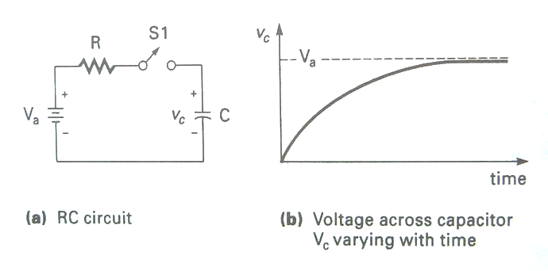
1.1 Digital and Analog Quantities
V_{c}(0)=0V, Initial voltage at t₀ is 0V
V_{c}=V_{a}(1-e^{-t/RC})
Notes:
Consider the simple RC circuit in Figure 1. Perhaps you have encountered such a circuit in a physics or introductory electronics course. Let the initial charge of capacitor C equal zero; when switch S1 is closed, the voltage across C will vary continuously from 0 volts to the maximum of the battery voltage, Va
The voltage developed across C, Figure (b), illustrates as an analog function; C increases exponentially [ˌɛkspoʊˈnɛnʃəli] until it reaches the same value Va at t=∞ (infinite). The “continuous” nature of the information is what cause it to be classified as analog.

Slide 9
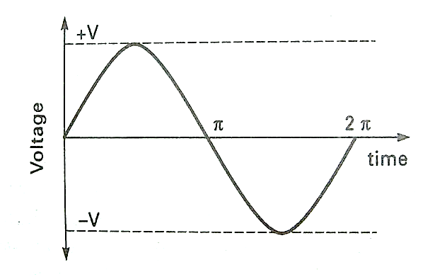
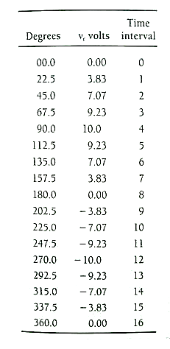
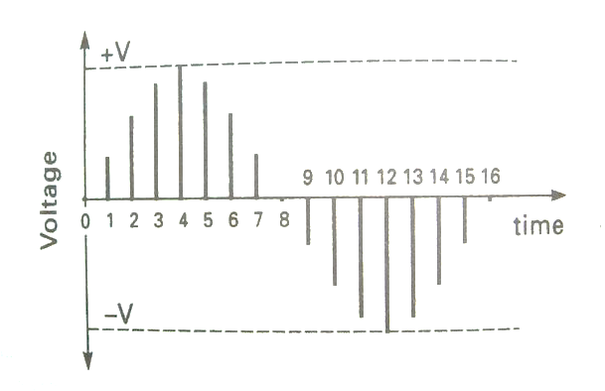
1.1 Digital and Analog Quantities
Discrete voltage values for time interval
(a) Analog representation
(b) Discrete representation
Notes:
Electronic systems tend to be classified as either analog(continuous) or digital(discrete). The mathematics of analog systems relates input to output in a continuous fashion; an amplifier gain equation describes how the input voltage will be amplified as a function of frequency, for example. Digital systems also have the ability to transform inputs into outputs. However, data are represented discretely, usually in a binary (base-2) number system, instead of in the more familiar decimal number system. Binary numbers are used, instead of decimal(base-10), due to the ease with which they can be implemented using electronic devices. It is easier to make a transistor operate between two discrete values than ten, as would be necessary if decimal numbers were used. Number systems-decimal, binary, and others-will be discussed later in this chapter.
A sine wave can be represented in either a continuous (analog ) fashion or in a discrete (digital) fashion. Figure 1.2 illustrates the methods of representing the same function.
Figure 1.2 (a) illustrates a sine wave functions in a continuous or analog form, and Figure 1.2 (b) represents the same sine wave in a discrete or digital form. Each point of the sine wave shown in Figure 1.2 (b) is represented by a discrete voltage at some time(t). Digital representation of a discrete voltage may be in decimal number system or some other number system, such as binary. It is not the number system used that makes the representation digital but rather that the measurements are taken at separate intervals of time.
Let each discrete value for the sine wave shown in Figure 1.2 (b) be expressed in a three-digit decimal number as presented in table 1.1. Let a cycle of the sine wave be divided into 16 equal time intervals, each representing 22.5 degrees. The time division is arbitrary for this example; it certainly could be divided differently. The number of horizontal divisions determines time resolution, and the number of digits for each interval determines the voltage resolution of the function. table 1.1could also be represented in base-2 numbers, or any other number system.
Discrete representation of a function provides useful information only at the time it was generated. If, for instance, a measurement was taken at time inverval 6, then v_{c}=7.07v. Voltage v_{c} is updated at time interval 7 to 3.83V; in between time intervals 6 and 7 the value of Vc is unknown.

Slide 10
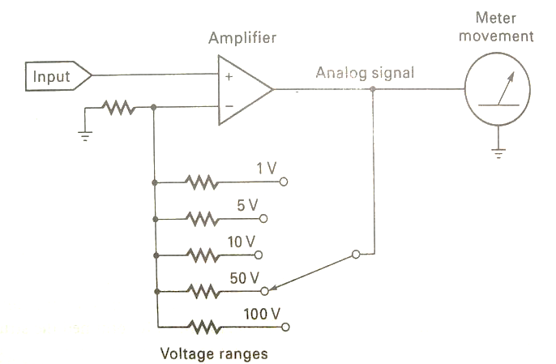
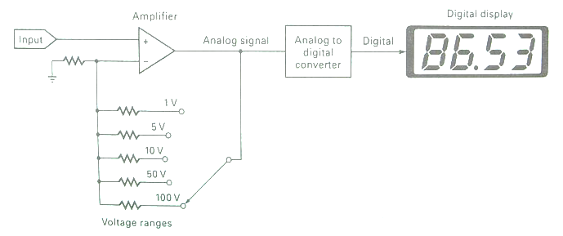
1.1 Digital and Analog Quantities
Analog volt meter
Digital volt meter
Notes:
Figure 1.3 shows a block diagram of atypical analog meter for measuring voltage. The input voltage is analog. A rang select switch allows the user to choose the setting for making a reading. An output meter continuously indicates the resulting voltage values. Figure 1.4 illustrates a digital volt meter. Notice that the input section is the same as the analog meter. An analog-to-digital converter is used to transform the continuous analog voltage to a discrete decimal value prior to display.

Slide 11
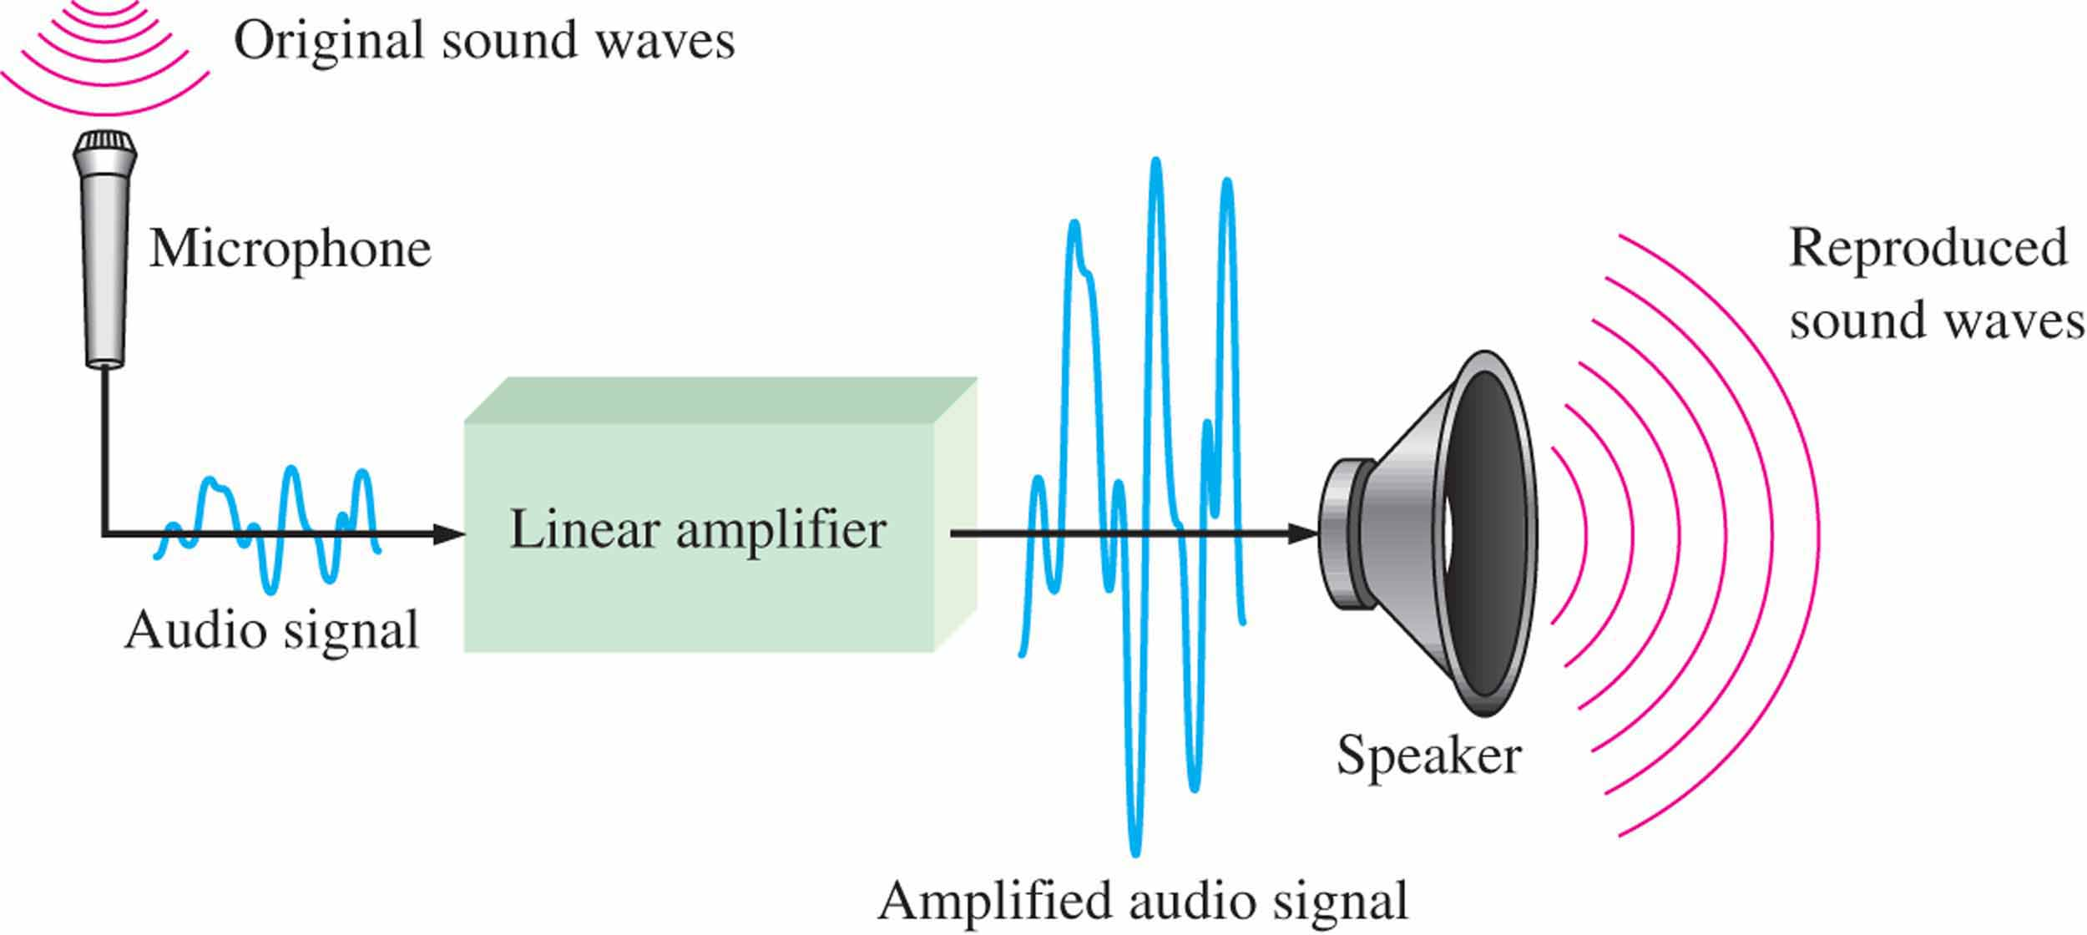
Figure 1.3 A basic audio public address system.
Notes:
A public address system, used to amplify sound so that it can be heard by a large audience, is one simple example of an application of analog electronics. The basic diagram in Figure 1.3 illustrates that sound waves, which are analog in nature, are picked up by a microphone and converted to a small analog voltage called the audio signal. This voltage varies continuously as the volume and frequency of the sound changes and is applied to the input of a linear amplifier. The output of the amplifier, which is an increased reproduction of input voltage, goes to the speaker(s). The speaker changes the amplified audio signal back to sound waves that have a much greater volume than the original sound waves picked up by the microphone.

Slide 12
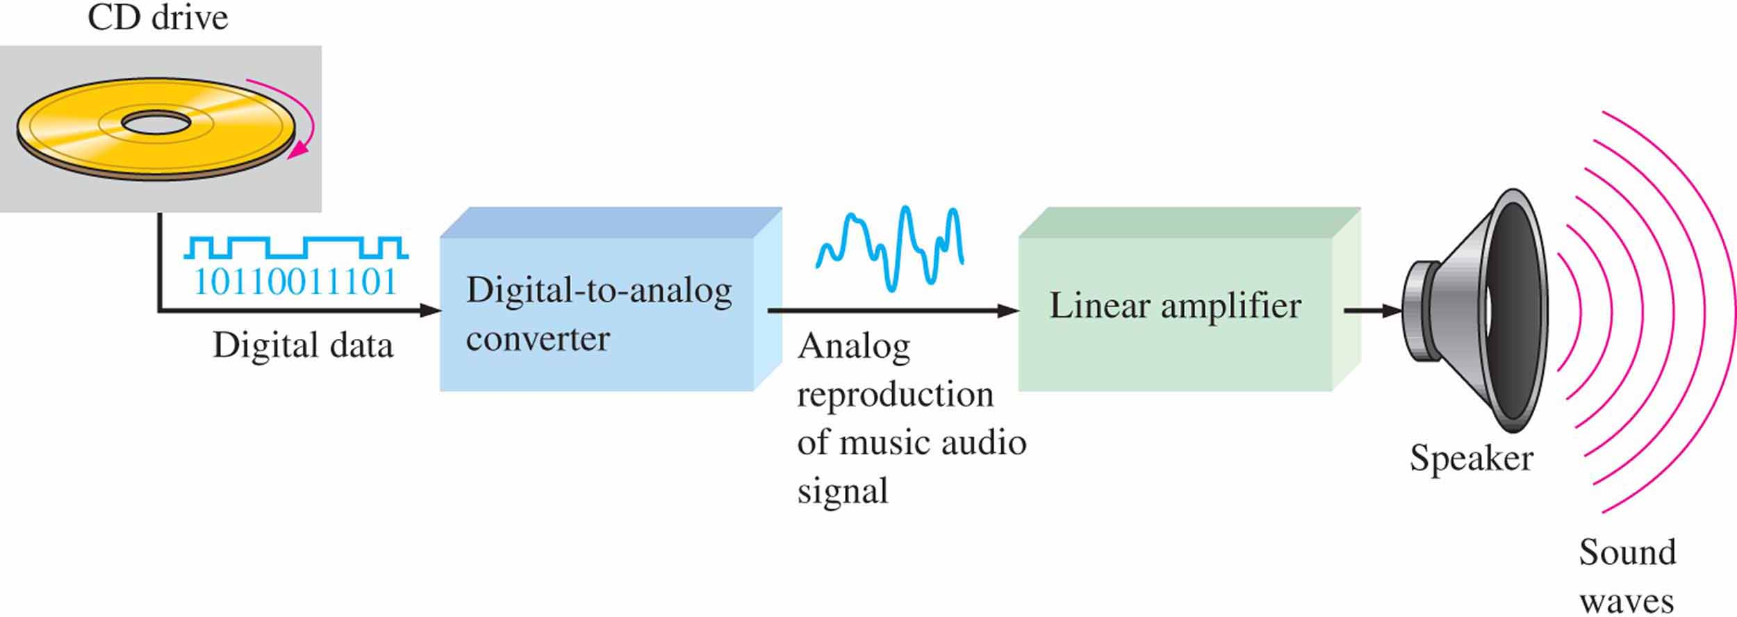
Figure 1.4 Basic block diagram of a CD player. Only one channel is shown.
Notes:
The compact disk (CD) player is an example of a system in which both digital and analog circuits are used. The simplified block diagram in Figure 1–4 illustrates the basic principle. Music in digital form is stored on the compact disk. A laser diode optical system picks up the digital data from the rotating disk and transfers it to the digital-to-analog converter (DAC). The DAC changes the digital data into an analog signal that is an electrical reproduction of the original music. This signal is amplified and sent to the speaker for you to enjoy. When the music was originally recorded on the CD, a process, essentially the reverse of the one described here, using an analog-to-digital converter (ADC) was used.

Slide 13
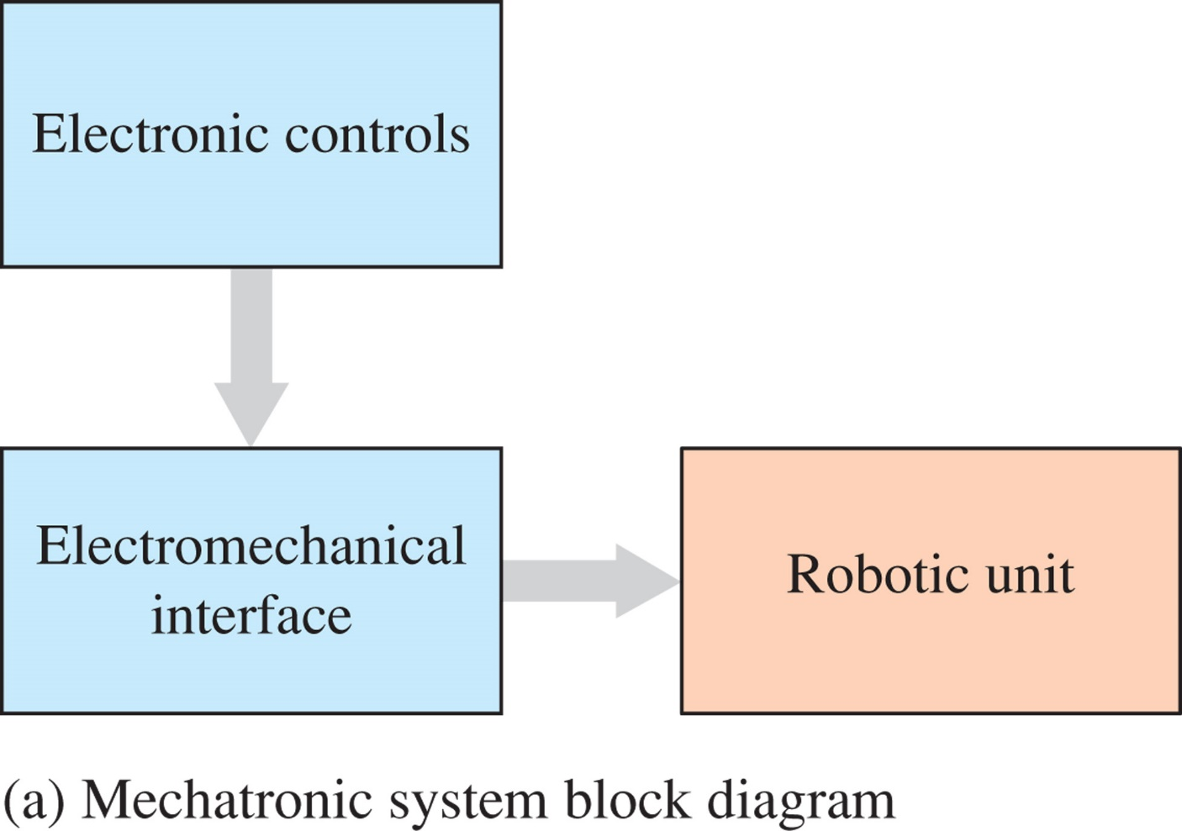
FIGURE 1-5a Example of a mechatronic system and application.

Slide 14
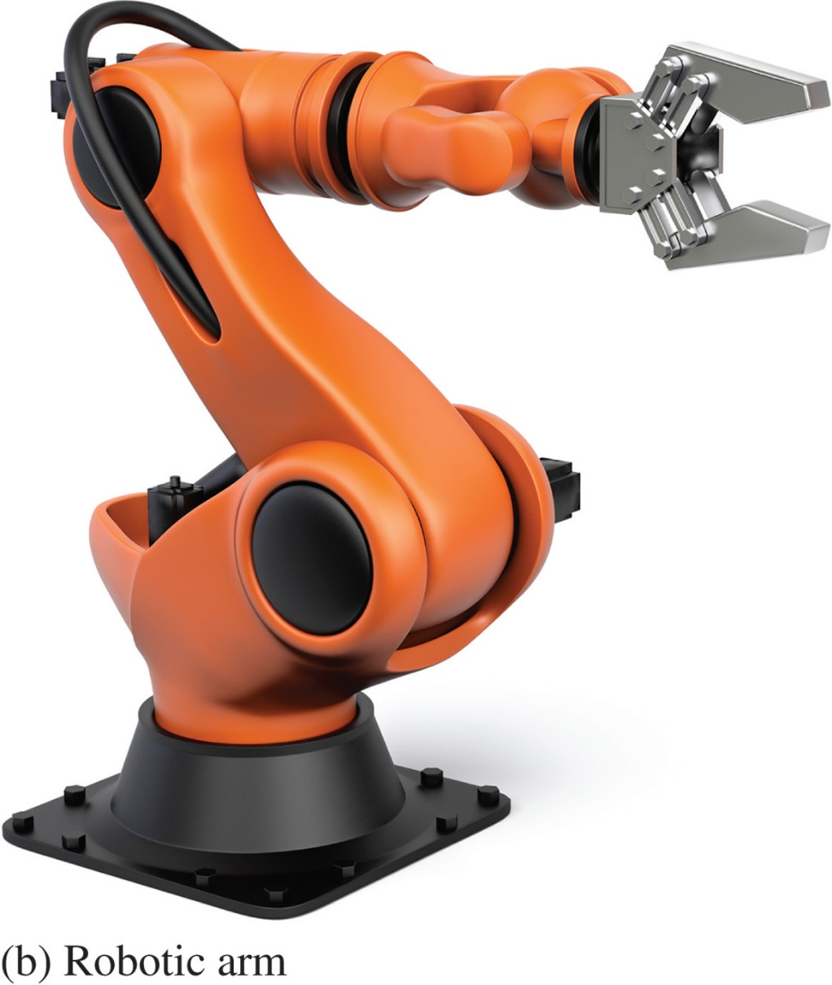
FIGURE 1-5b Example of a mechatronic system and application. Beawolf/Fotolia

Slide 15
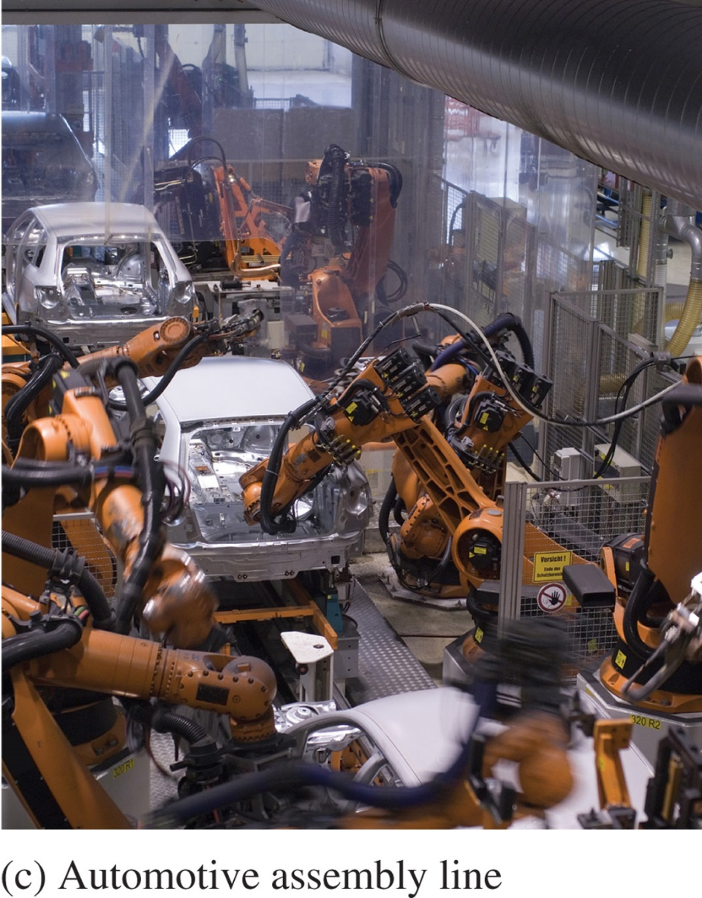
FIGURE 1-5c Example of a mechatronic system and application. Small Town Studio/Fotolia.

Slide 16
The Digital Advantage: Digital representation has certain advantages over analog representation in electronics applications. For one things, digital data can be processed and transmitted more efficiently than analog data. Also, digital data has a great advantage when storage is necessary. For example, Music when converted to digital form can be stored more compactly and reproduced with greater accuracy and clarity than is possible when it is in analog form. Noise (unwanted voltage fluctuations) does not affect digital data nearly as much as it does analog signals.

Slide 17
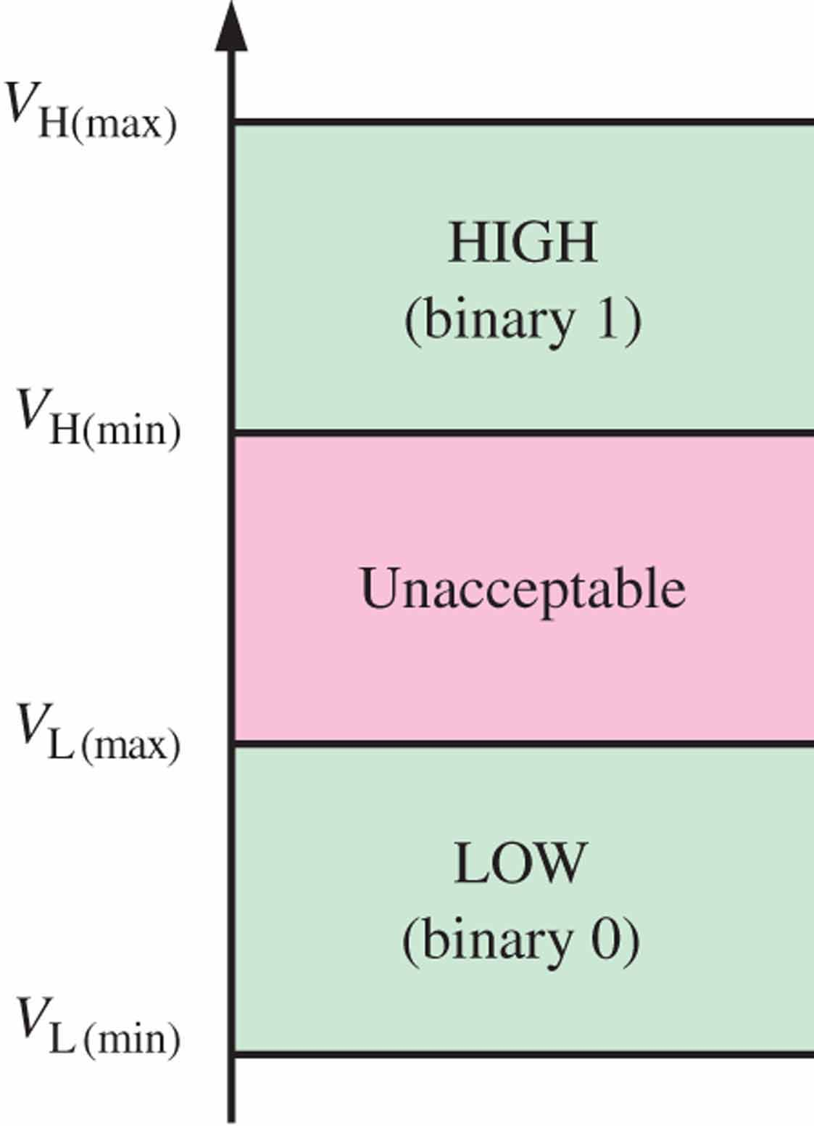
Figure 1.5 Logic level ranges of voltage for a digital circuit.
1.2 Binary digital, Logic Levels, and Digital Waveforms
Binary Digits
Each of the two digits in the binary system, 1 and 0, is called a bit.
Two different voltage levels are used to represent the two bits.
Logic Levels
Notes:
接PPT
For example, the HIGH input values for a certain type of digital circuit technology called CMOS(Complementary Metal Oxide Semiconductor ) may range from 2 V to 3.3 V and the LOW input values may range from 0 V to 0.8 V. If a voltage of 2.5 V is applied, the circuit will accept it as a HIGH or binary 1. If a voltage of 0.5 V is applied, the circuit will accept it as a LOW or binary 0. For this type of circuit, voltages between 0.8 V and 2 V are unacceptable.

Slide 18
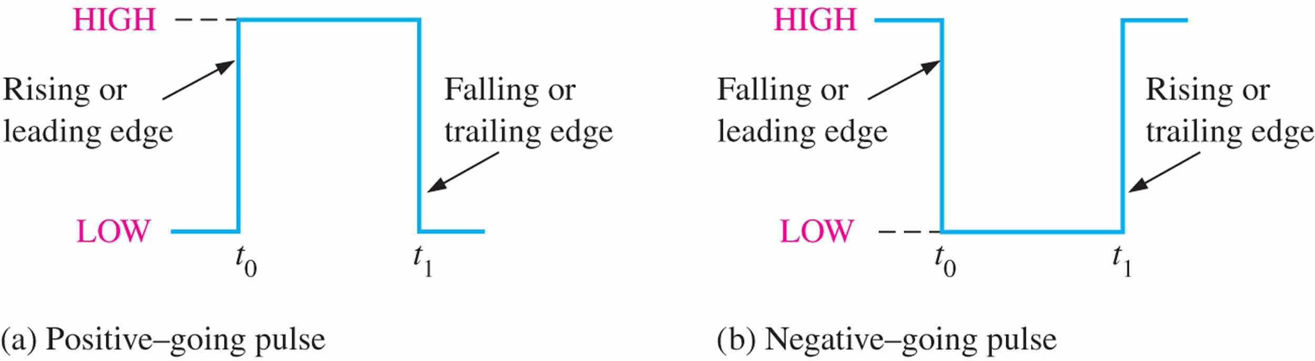
Figure 1.7 Ideal pulses.
1.2 Binary digital, Logic Levels, and Digital Waveforms
3 Digital Waveforms
Digital waveforms consist of voltage levels that are changing back and forth between the HIGH and LOW levels or states.
Notes:
Digital waveforms consist of voltage levels that are changing back and forth between the HIGH and LOW levels or states. Figure 1.7 shows that a single positive-going pulse is generated when the voltage (or current) goes from its normally LOW level to its HIGH level and then back to its LOW level. The negative-going pulse in Figure 1.7(b) is generated when the voltage goes from its normally HIGH level to its LOW level and back to its HIGH level. A digital waveform is made up of a series of pulses.

Slide 19
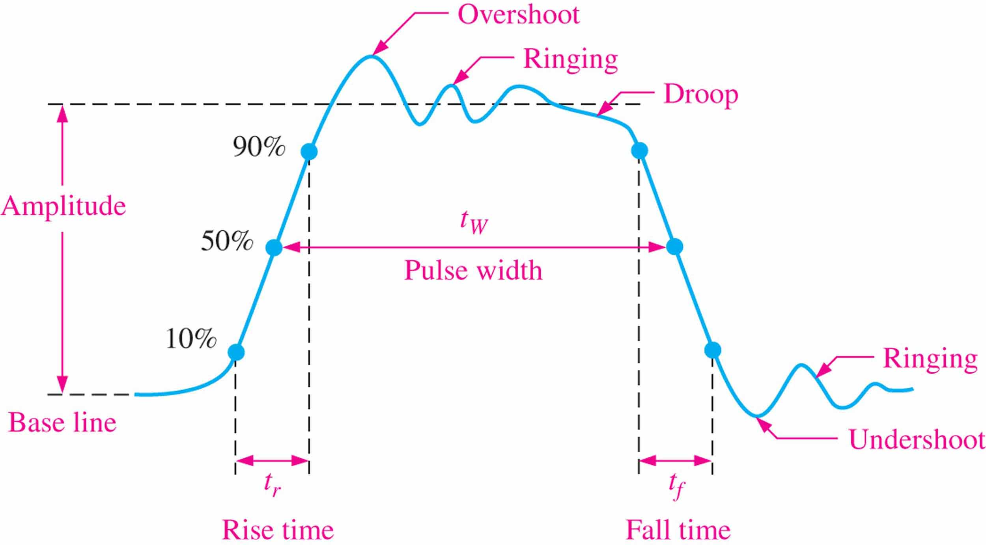
Figure 1.8 Nonideal pulse characteristics.
1.2 Binary digital, Logic Levels, and Digital Waveforms
Notes:
As indicated in Figure 1.8, a pulse has two edges: a leading edge that occurs first at time t₀ and a trailing edge that occurs last at time t₁. For a positive-going pulse, the leading edge is a rising edge, and the trailing edge is a falling edge. The pulses in Figure 1–7 are ideal because the rising and falling edges are assumed to change in zero time (instantaneously). In practice, these transitions never occur instantaneously, although for most digital work you can assume ideal pulses.
Figure 1–8 shows a nonideal pulse. In reality, all pulses exhibit some or all of these characteristics. The overshoot(过冲) and ringing are sometimes produced by stray inductive(杂散电感) and capacitive effects(电容效应). The droop can be caused by stray capacitive(杂散电容) and circuit resistance, forming an RC circuit with a low time constant.
The time required for a pulse to go from its LOW level to its HIGH level is called the rise time (t_{r}), and the time required for the transition from the HIGH level to the LOW level is called the fall time (t_{f}). In practice, it is common to measure rise time from 10% of the pulse amplitude (height from baseline) to 90% of the pulse amplitude and to measure the fall time from 90% to 10% of the pulse amplitude, as indicated in Figure 1–8. The bottom 10% and the top 10% of the pulse are not included in the rise and fall times because of
the nonlinearities in the waveform in these areas. The pulse width (t_{W}) is a measure of the duration of the pulse and is often defined as the time interval between the 50% points on the rising and falling edges, as indicated in Figure 1.8.

Slide 20
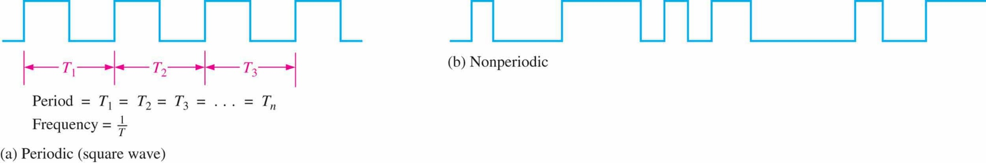
Figure 1.9 Examples of digital waveforms.
1.2 Binary digital, Logic Levels, and Digital Waveforms
Waveform Characteristics
A periodic pulse waveform is one that repeats itself at a fixed interval, called a period (T). The frequency ( f ) of a pulse (digital) waveform is the reciprocal of the period.
A nonperiodic pulse waveform does not repeat itself at fixed intervals and may be composed of pulses of randomly differing pulse widths and/or randomly differing time intervals between the pulses.
Notes:
Most waveforms encountered in digital systems are composed of series of pulses, sometimes called pulse trains, and can be classified as either periodic or nonperiodic.
接PPT （以下是一样内容）
【A periodic pulse waveform is one that repeats itself at a fixed interval, called a period (T). The frequency ( f ) is the rate at which it repeats itself and is measured in hertz (Hz).
A nonperiodic pulse waveform, of course, does not repeat itself at fixed intervals and may be composed of pulses of randomly differing pulse widths and/or randomly differing time intervals between the pulses.】

Slide 21
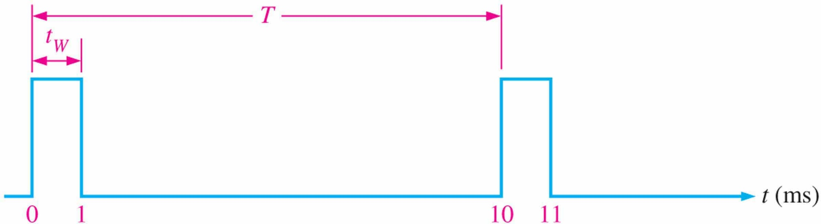
Figure 1.10
1.2 Binary digital, Logic Levels, and Digital Waveforms
EXAMPLE 1–1 A portion of periodic digital waveform is shown in Figure 1.10. The measurements are in milliseconds. Determine the following:
(a) period (b) frequency (c)duty cycle
Notes:
接PPT
The frequency ( f ) of a pulse (digital) waveform is the reciprocal of the period(T).
The period(T) of a pulse (digital) waveform is the reciprocal of the frequency ( f ) .
An important characteristic of a periodic digital waveform is its duty cycle, which is the
ratio of the pulse width (t_{W}) to the period (T ). It can be expressed as a percentage.

Slide 22
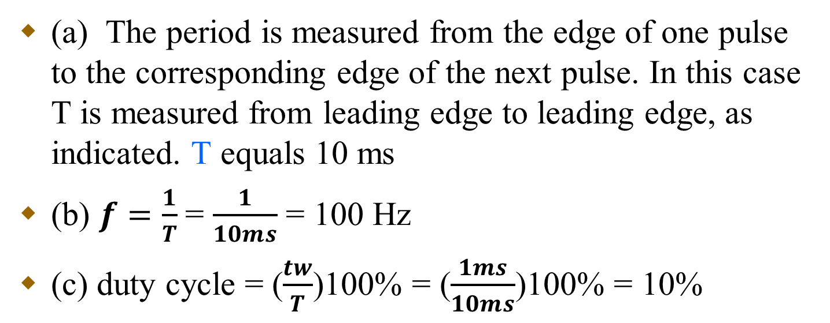
Figure 1.10
EXAMPLE 1-1
Notes:
Solution
So let’s see the answer to the question:
(a) The period (T) is measured from the edge of one pulse to the corresponding edge of the next pulse. In this case T is measured from leading edge to leading edge, as indicated. T equals 10 ms.
(b) f = 1/T =1/10 ms = 100 Hz
(c) Duty cycle = (t_{W} / T )*100% = ( 1 ms/10 ms)*100% = 10%

Slide 23
1.2.4 A Digital Waveform carries Binary Information
Binary information that is handled by digital system appears as waveforms that represent sequences of bits. When the waveform is HIGH, a binary 1 is present; when the waveform is LOW, a binary 0 is present. Each bit in a sequence occupies a defined time interval called a bit time.
The clock In digital systems, all waveforms are synchronized with a basic timing waveform called the clock.

Slide 24
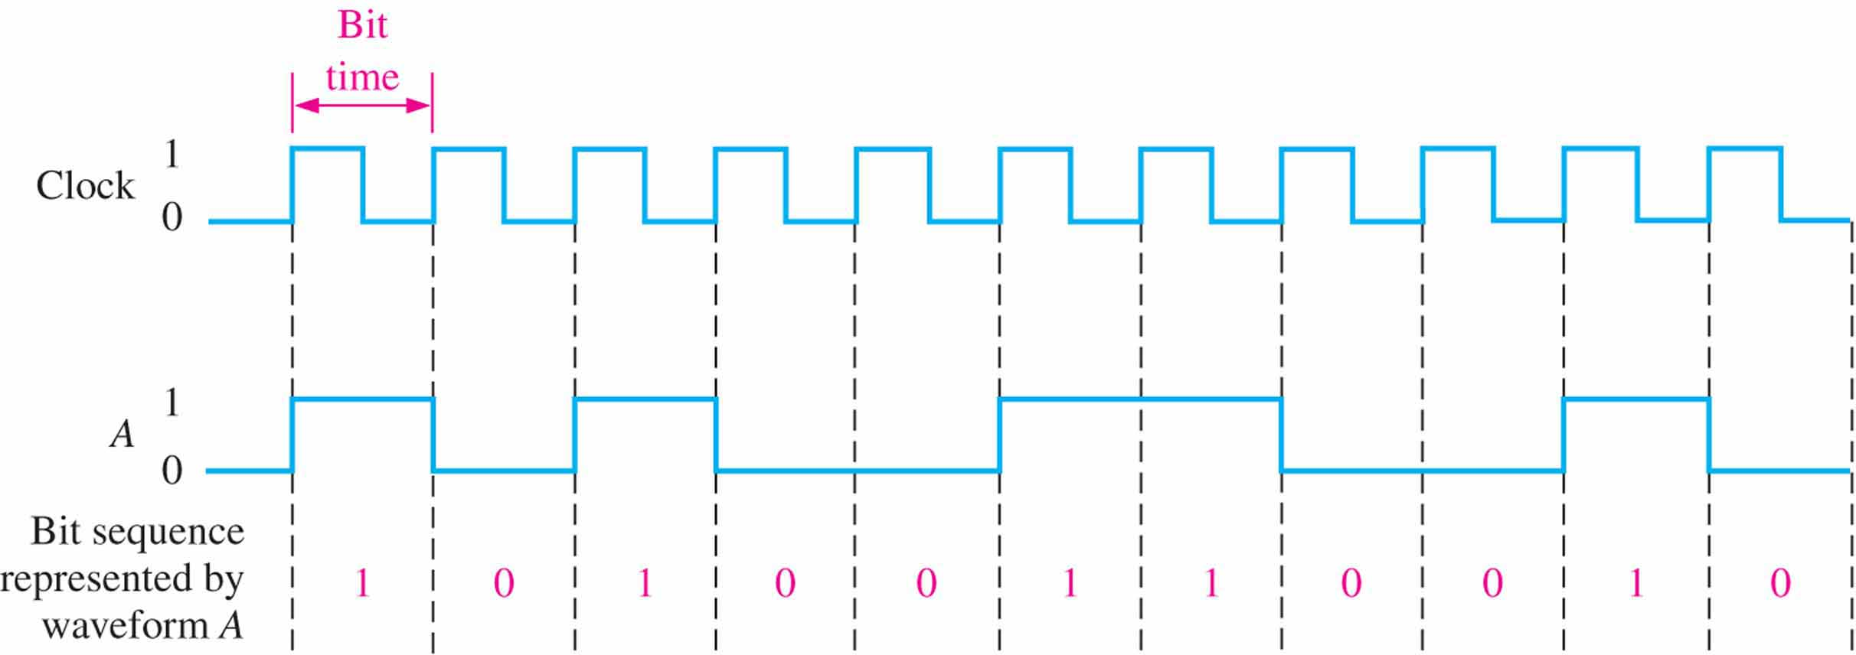
1.2.4 A Digital Waveform carries Binary Information
Figure 1.11 Example of a clock waveform synchronized with a waveform representation of a sequence of bits.
Each change in level of waveform A occurs at the leading of clock waveform.
During each bit time of the clock, waveform A is either HIGH or LOW， These HIGH and LOWs represent a sequence of bits as indicated.
A group of several bits can be used as a piece of binary information, such as a number or a letter.
Notes:
An example of a clock waveform is shown in Figure 1.11. Notice that, in this case, each change in level of waveform A occurs at the leading edge of the clock waveform. In other cases, level changes occur at the trailing edge of the clock. During each bit time of the clock, waveform A is either HIGH or LOW. These HIGHs and LOWs represent a sequence of bits as indicated. A group of several bits can contain binary information, such as a number or a letter. The clock waveform itself does not carry information.

Slide 25
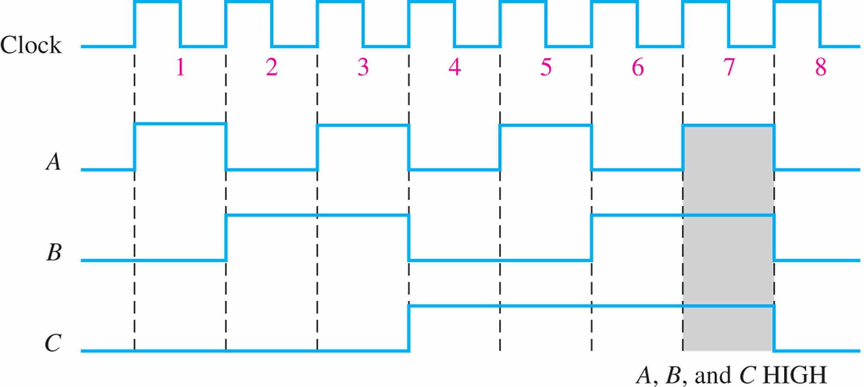
1.2.4 A Digital Waveform carries Binary Information
Figure 1.12 Example of a timing diagram.
Timing Diagrams：A timing diagram is a graph of digital waveforms showing the actual time relationship of two or more waveforms and how each waveform changes in relation to the others. example→
Notes:
A timing diagram is a graph of digital waveforms showing the actual time relationship of two or more waveforms and how each waveform changes in relation to the others. By looking at a timing diagram, you can determine the states (HIGH or LOW) of all the waveforms at any specified point in time and the exact time that a waveform changes state relative to the other waveforms. Figure 1.12 is an example of a timing diagram made up of four waveforms. From this timing diagram you can see, for example, that the three waveforms A, B, and C are HIGH only during bit time 7 (shaded area) and they all change back LOW at the end of bit time 7.

Slide 26
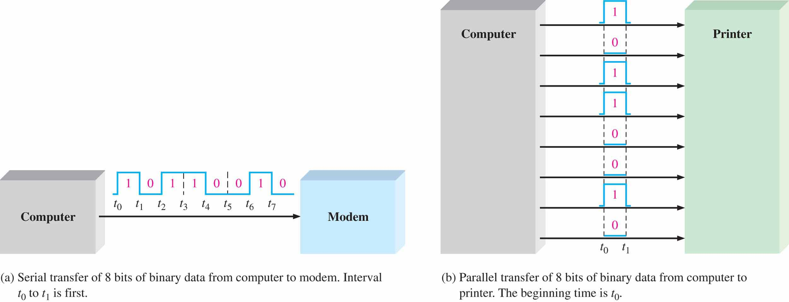
1.2.5 Data Transfer
Figure 1.13 Illustration of serial and parallel transfer of binary data. Only the data lines are shown.
When bits are transferred in serial form from one point to another, they are sent one bit at a time along a single line, as illustrated in Figure 1-13 (a)
When bits are transferred in parallel form, all the bits in a group are sent out on separate lines at the same time. as shown in Figure 1-13 (b)
Notes:
Data refers to groups of bits that convey some type of information. Binary data, which are represented by digital waveforms, must be transferred from one device to another within a digital system or from one system to another in order to accomplish a given purpose.
As illustrated in Figure 1.13, binary data are transferred in two ways: serial and parallel.
接PPT
When bits are transferred in serial form from one point to another, they are sent one bit at a time along a single line, as illustrated in Figure 1.13(a). During the time interval from t₀ to t₁, the first bit is transferred. During the time interval from t₁ to t₂, the second bit is transferred, and so on. To transfer eight bits in series, it takes eight time intervals.
When bits are transferred in parallel form, all the bits in a group are sent out on separate lines at the same time. There is one line for each bit, as shown in Figure 1.13(b) for the example of eight bits being transferred. To transfer eight bits in parallel, it takes one time interval compared to eight time intervals for the serial transfer.

Slide 27
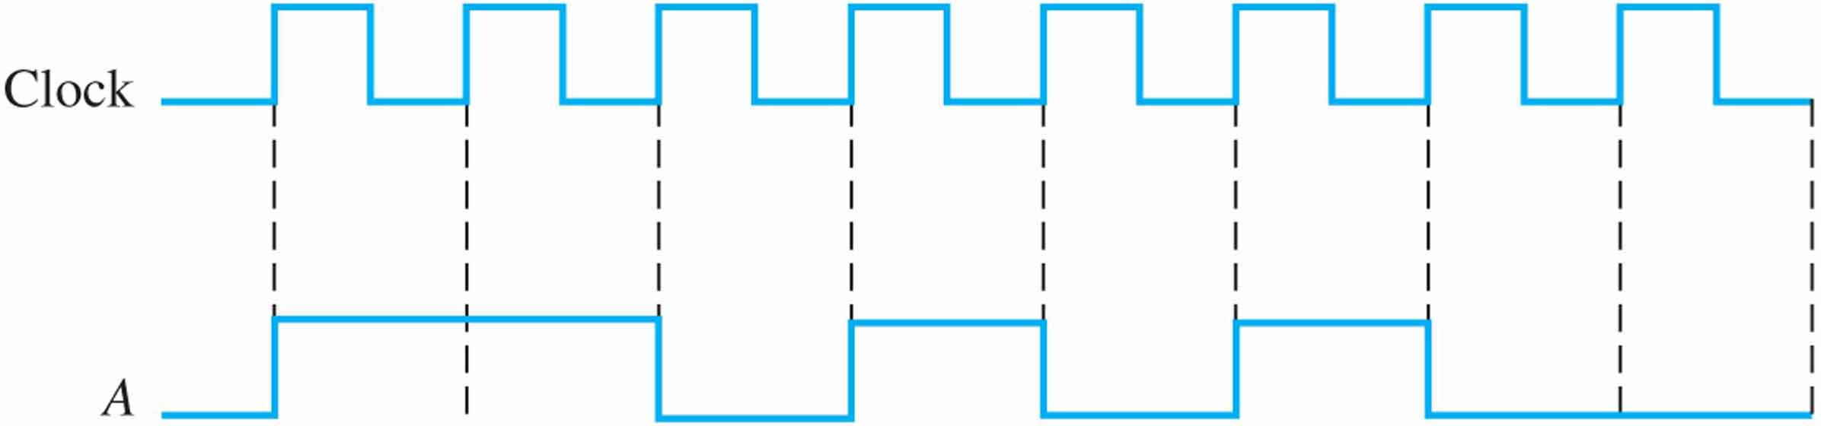
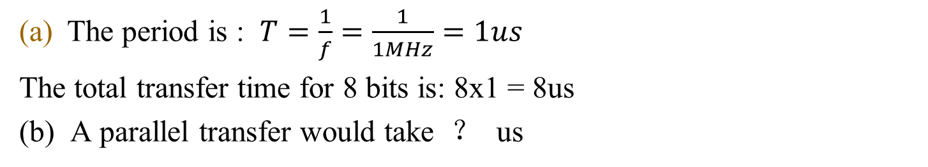
1.2.5 Data Transfer
EXAMPLE 1-2
Determine the total time required to serially transfer the eight bits contained in waveform A of Figure1-14, and indicate the sequence of bits. The left-most bit is the first to be transferred. The 1 MHz clock is used as reference.
What the total time to transfer the same eight bit in parallel?
FIGURE 1–14
Notes:
接PPT
Since the frequency of the clock is 1 MHz, the period is : 1us
It takes 1 us (microsecond (μs) ) to transfer each bit in the waveform. The total transfer time for 8 bits is:
1x8 =8 us
(b) A parallel transfer would take 1 us for all eight bits.

Slide 28
SECTION 1-2 CHECKUP
Define binary.
What does bit mean?
What are the bits in binary system?
How are the rise time and fall time for a pulse measured?
Knowing the period of a waveform, how do you find the frequency?
Explain what a clock waveform is.
What is the purpose of a timing diagram?
What is the main advantage of parallel transfer over serial transfer of binary data?

Slide 29
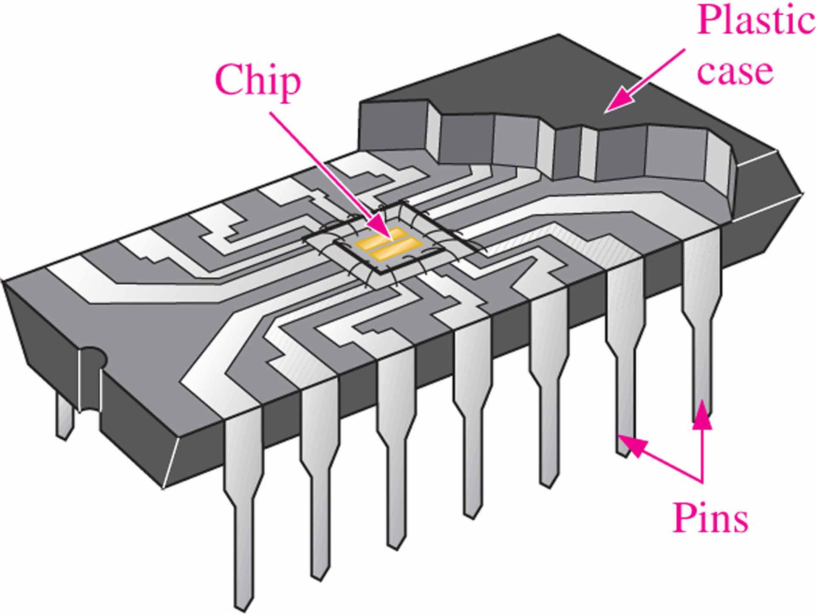
1.3 Fixed-Function Integrated circuits
A monolithic integrated circuit (IC) is an electronic circuit that is constructed entirely on a single small chip of silicon. All the components that make up the circuit – transistors, diodes, resistors, and capacitors – are an integral part of that single chip.

Slide 30
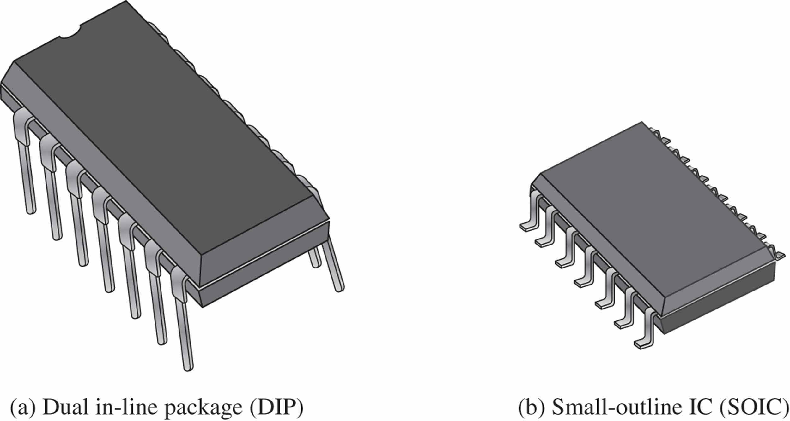
1.3.1 IC Package
Integrated circuit (IC) packages are classified according to the way they are mounted on printed circuit boards

Slide 31
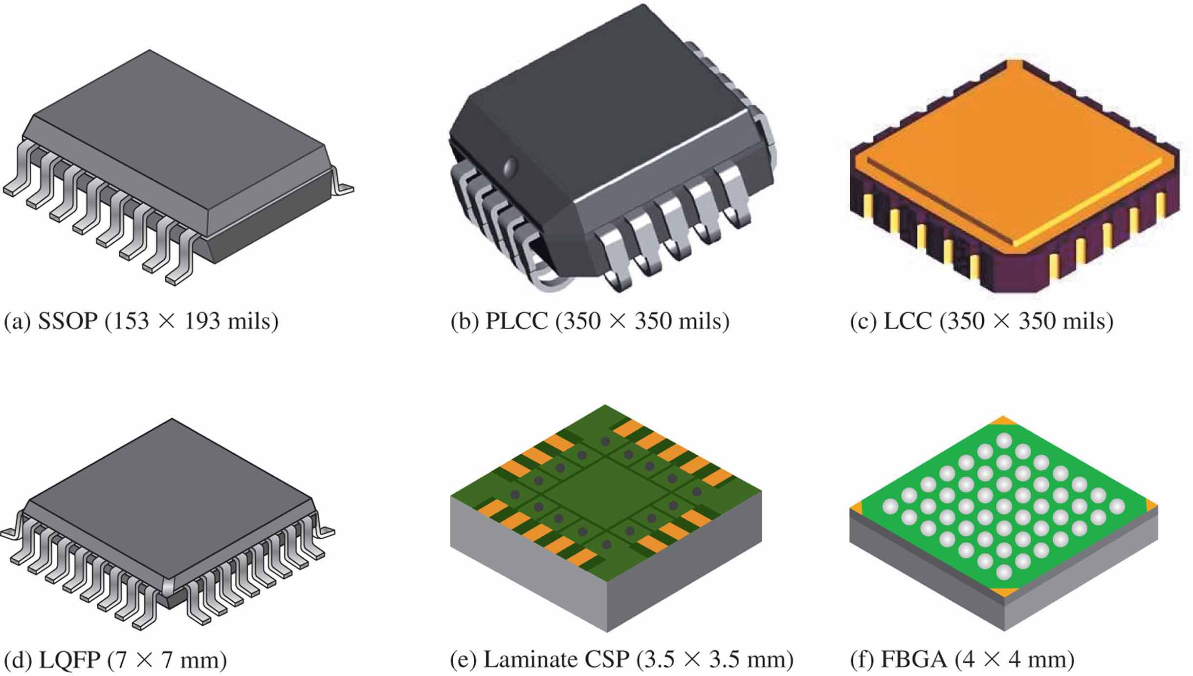
1.3.1 IC Package
Figure 1.17 Examples of SMT package configurations. Parts (e) and (f) show bottom views.

Slide 32
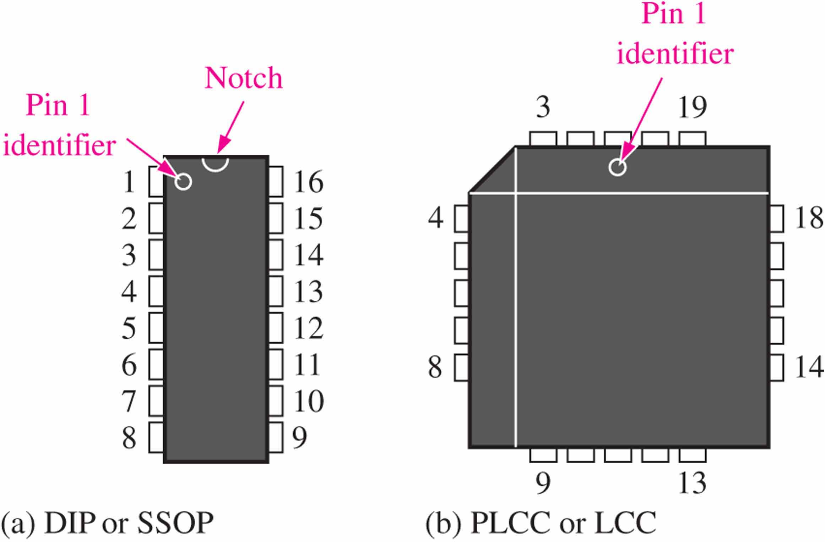
1.3.2 Pin Numbering
Figure 1.17 Pin numbering for standard types of IC packages. Top views are shown.

Slide 33
1.3.3 Complexity Classifications for Fixed-Function ICs
Fixed-function digital Ics are calssified to their complexity. They are listed here from the least complex to the most complex. The complexity figures stated here for SSL, MSL, LSI,VLSI, and ULSI are generally accepted,
SSI (small-scale integration) contains 0-9 gates
MSI (medium-scale integration) contains 10-99gates
LSI (large-scale integration) contains 100 or more gates
VLSI (very large-scale integration ) contains more than 10000 gates
ULSI(Ultra large-scale integration) contains more than 100000 gates

Slide 34
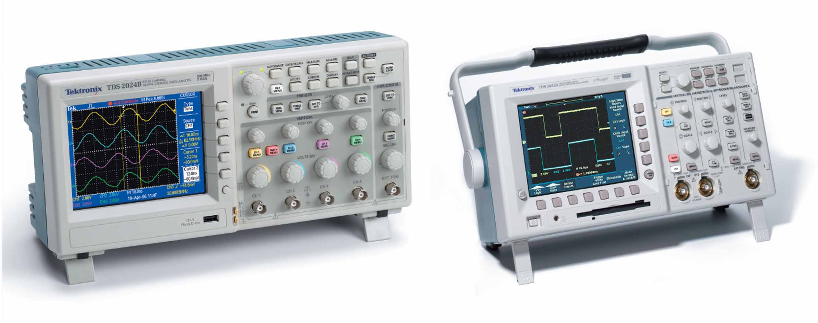
Chapter 1
Figure 1.18 Typical digital oscilloscopes. Used with permission from Tektronix, Inc.

Slide 35
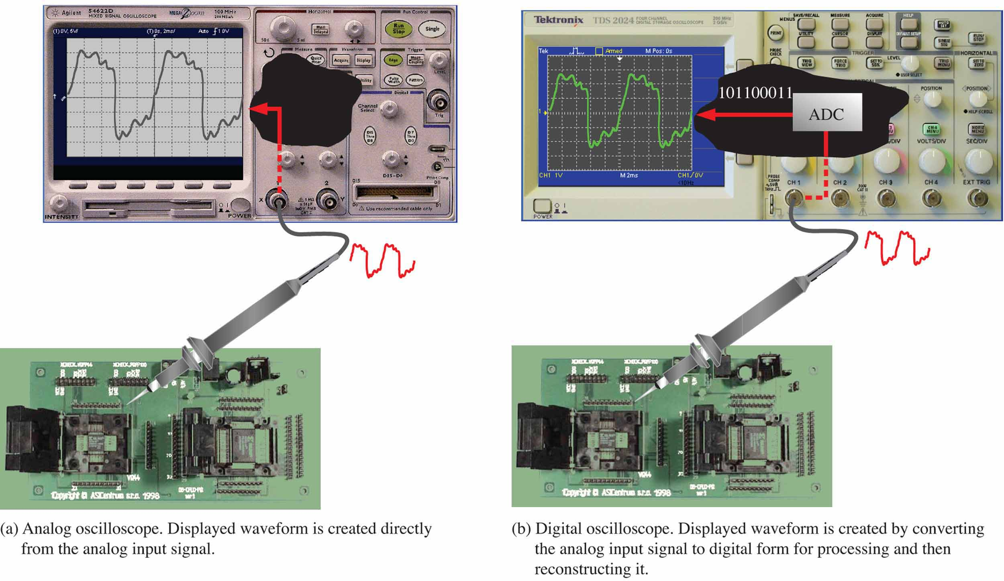
Chapter 1
Figure 1.19 Basic comparison of analog and digital oscilloscope operation.

Slide 36
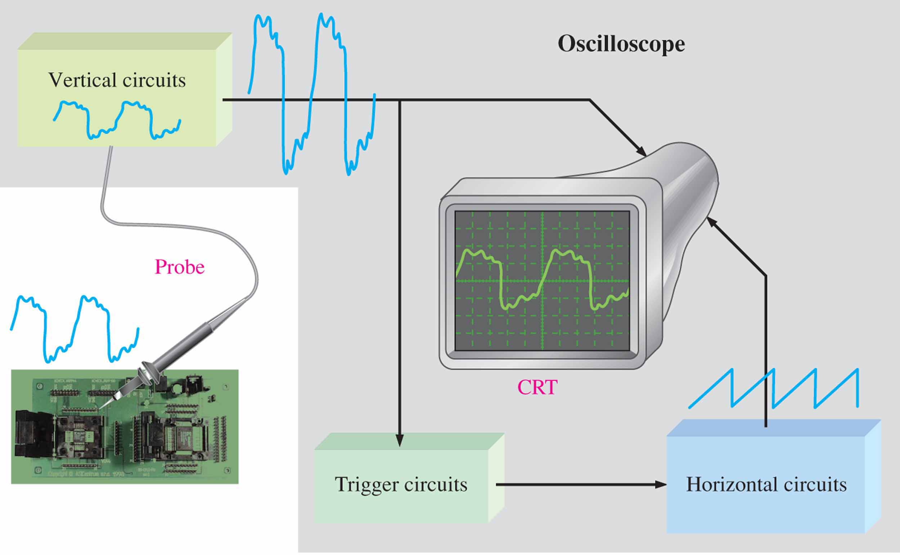
Chapter 1
Figure 1.20 Block diagram of an analog oscilloscope.

Slide 37
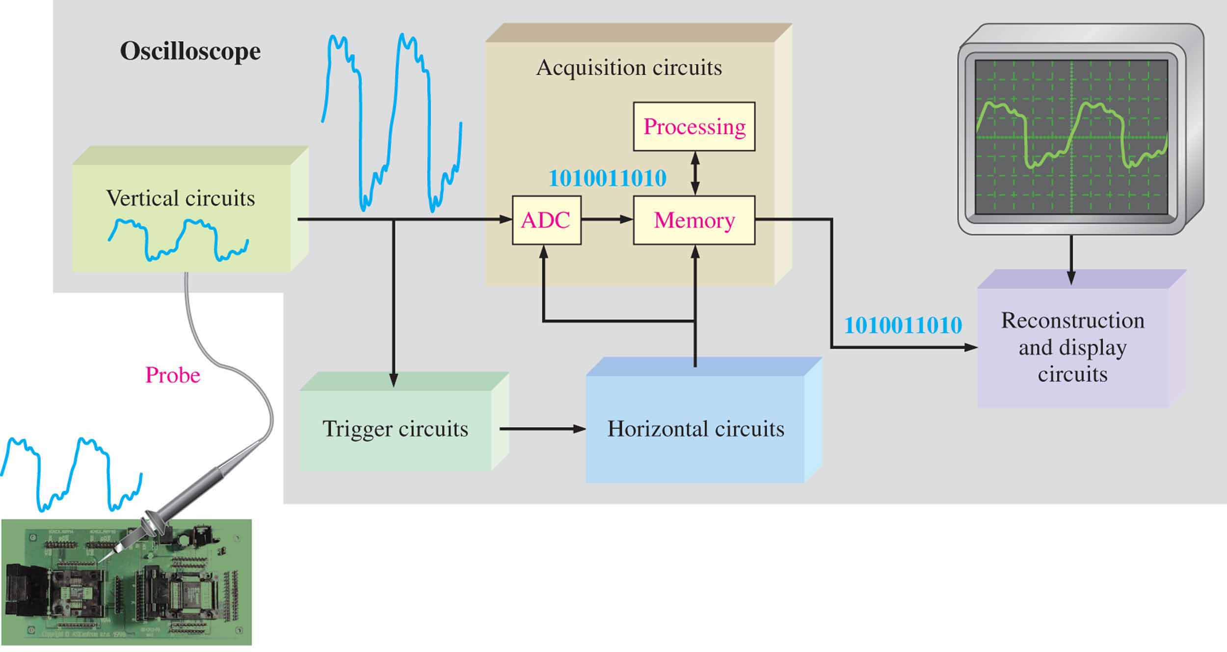
Chapter 1
Figure 1.21 Block diagram of a digital oscilloscope.

Slide 38
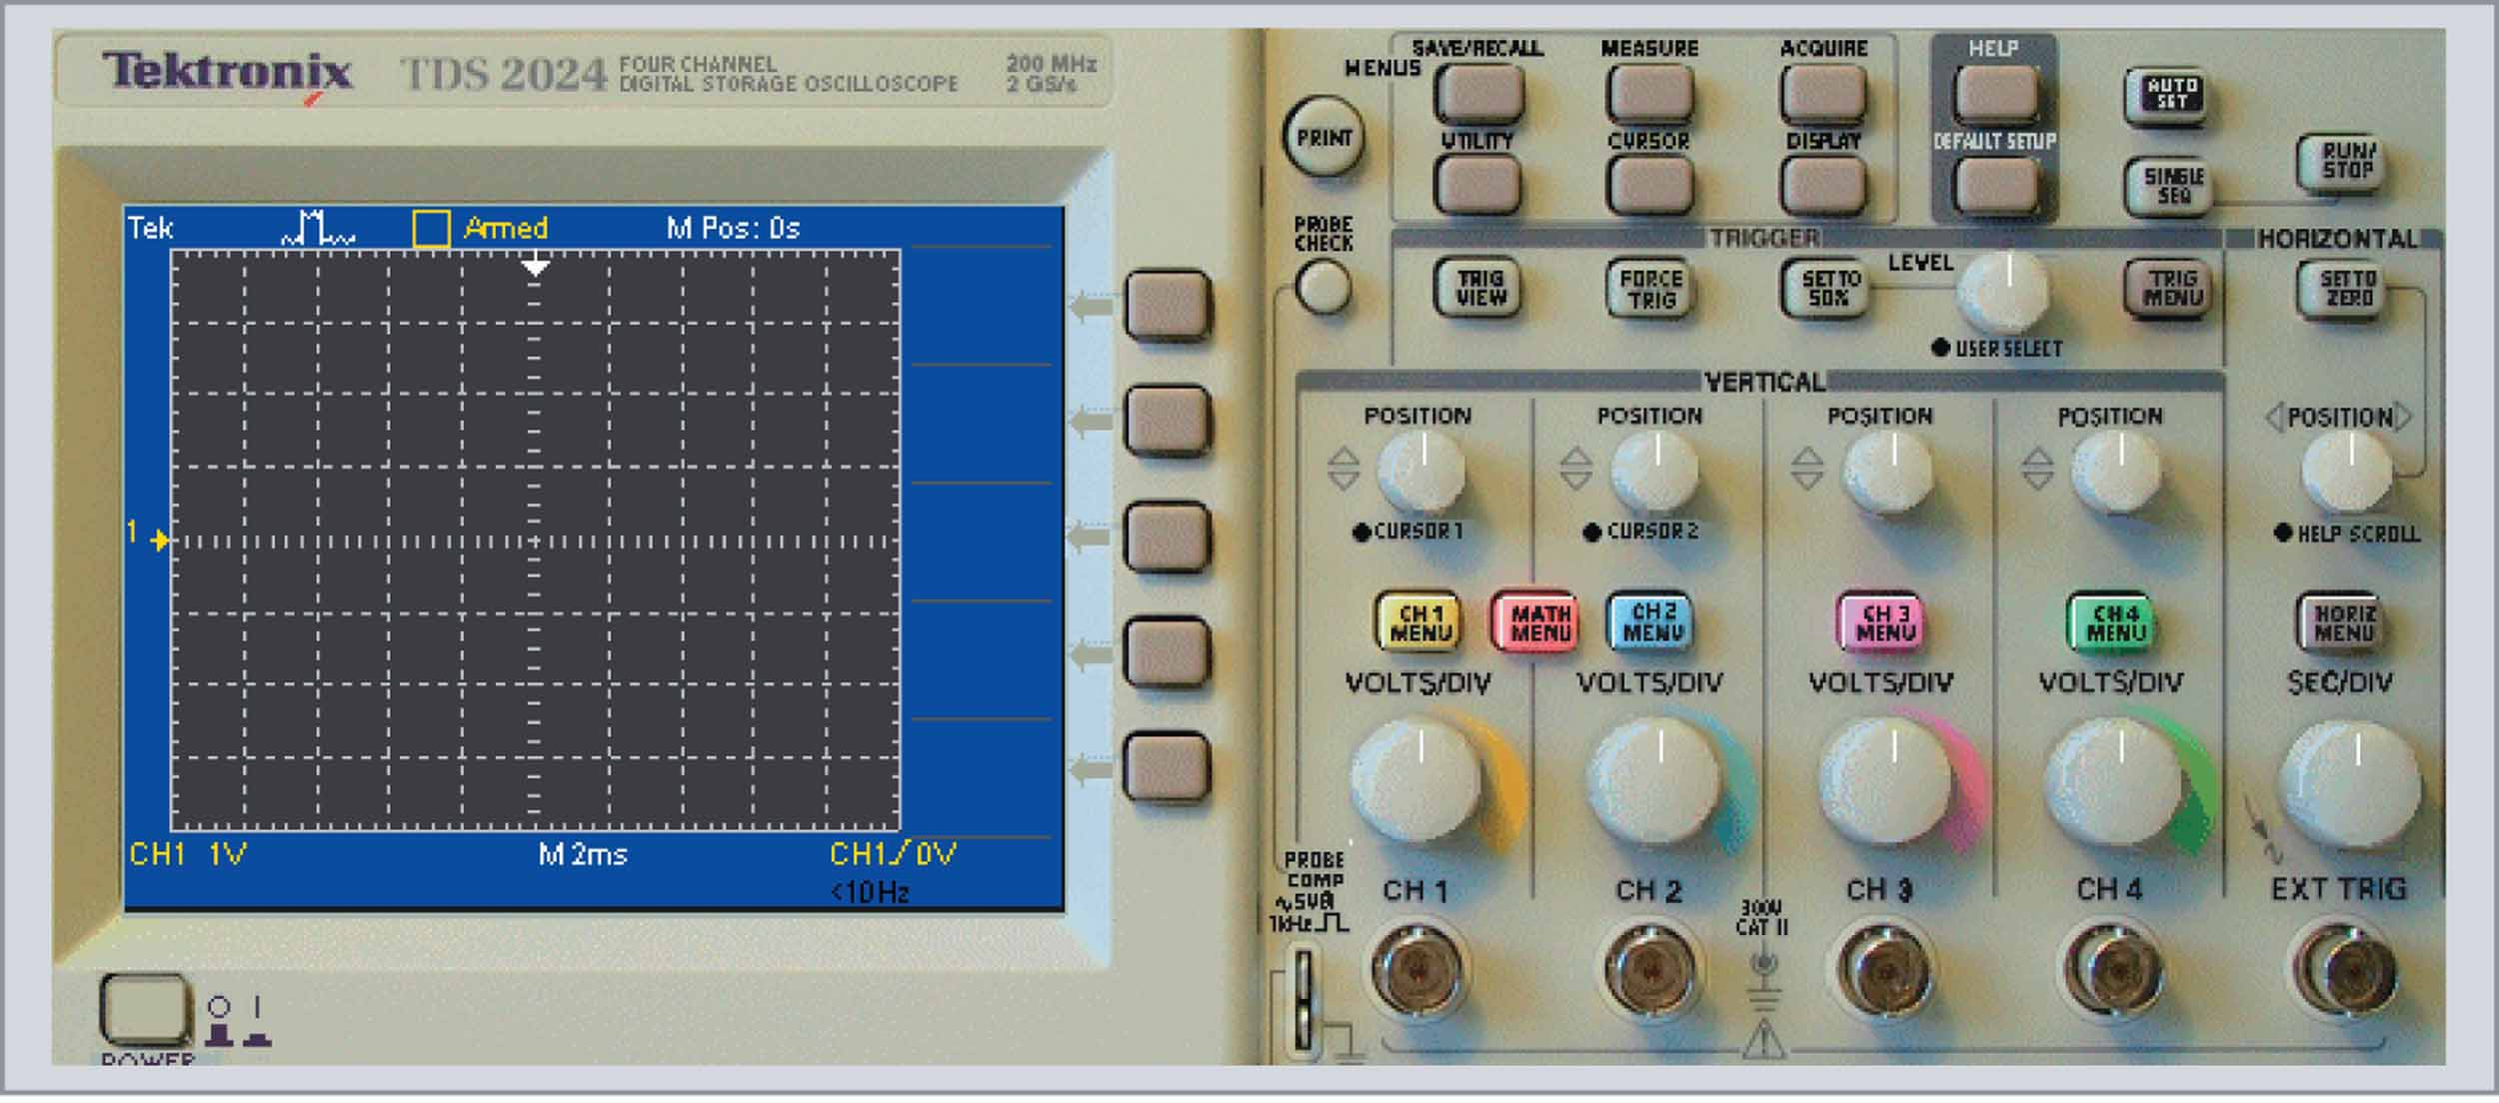
Chapter 1
Figure 1.22 Representation of a typical digital oscilloscope front panel. Numbers below screen indicate the values for each division on the vertical (voltage) and horizontal (time) scales and can be varied using the vertical and horizontal controls on the scope.

Slide 39
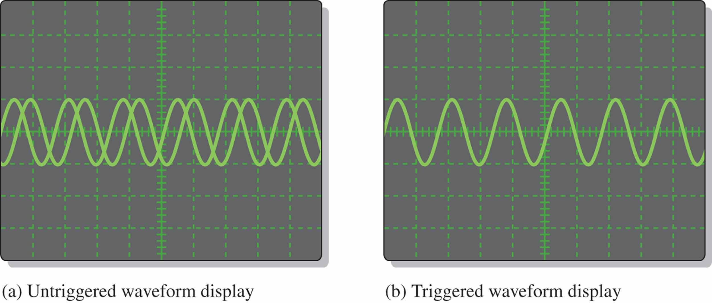
Chapter 1
Figure 1.23 Comparison of an untriggered and a triggered waveform on an oscilloscope.

Slide 40
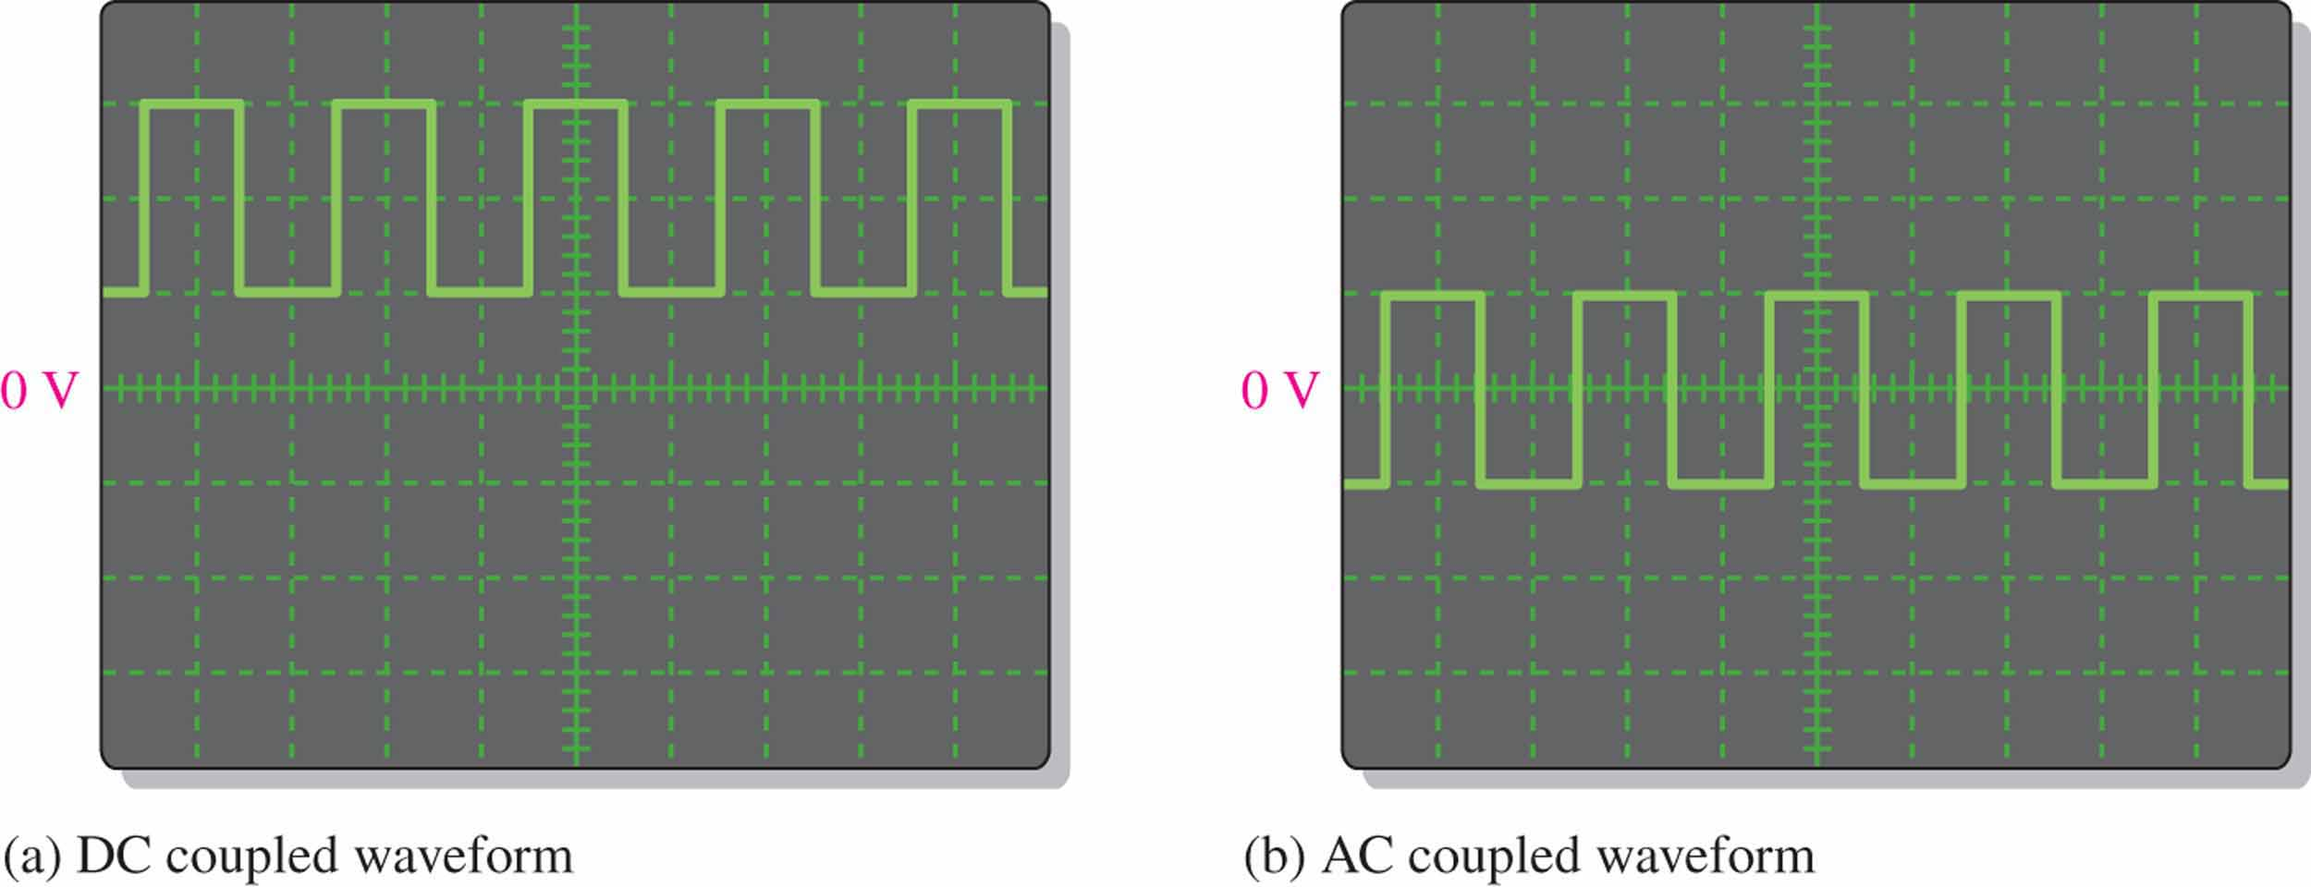
Chapter 1
Figure 1.24 Displays of the same waveform having a dc component.

Slide 41
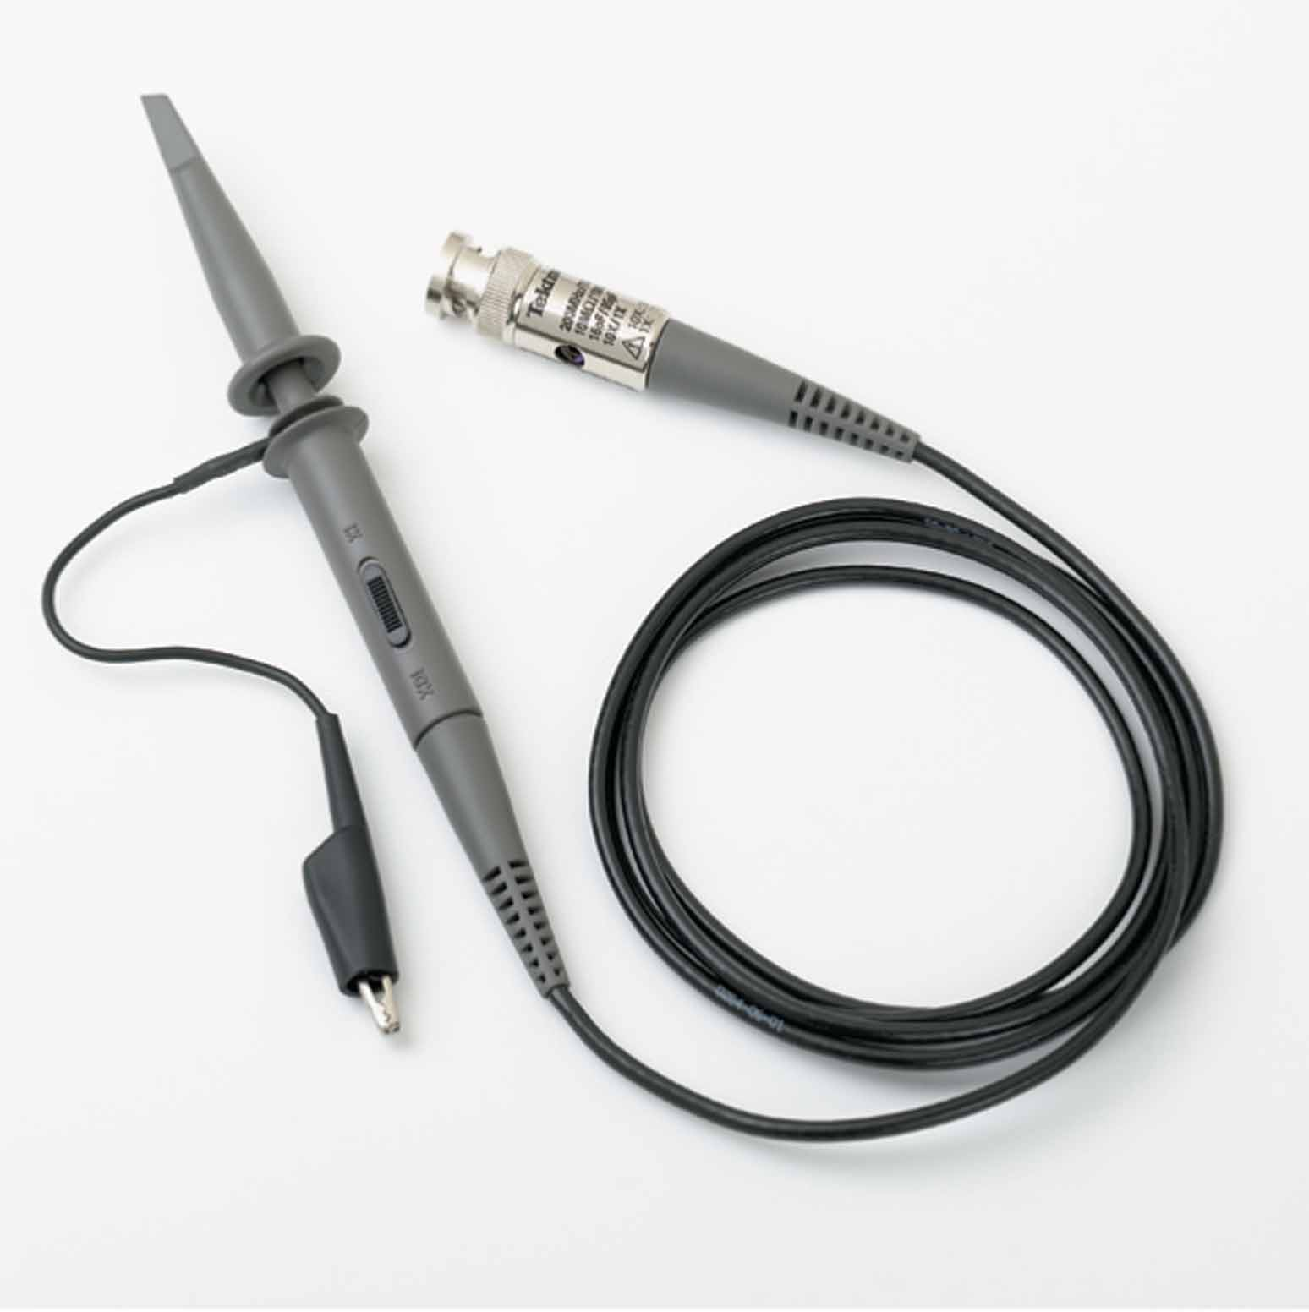
Chapter 1
Figure 1.25 An oscilloscope voltage probe. Used with permission from Tektronix, Inc

Slide 42
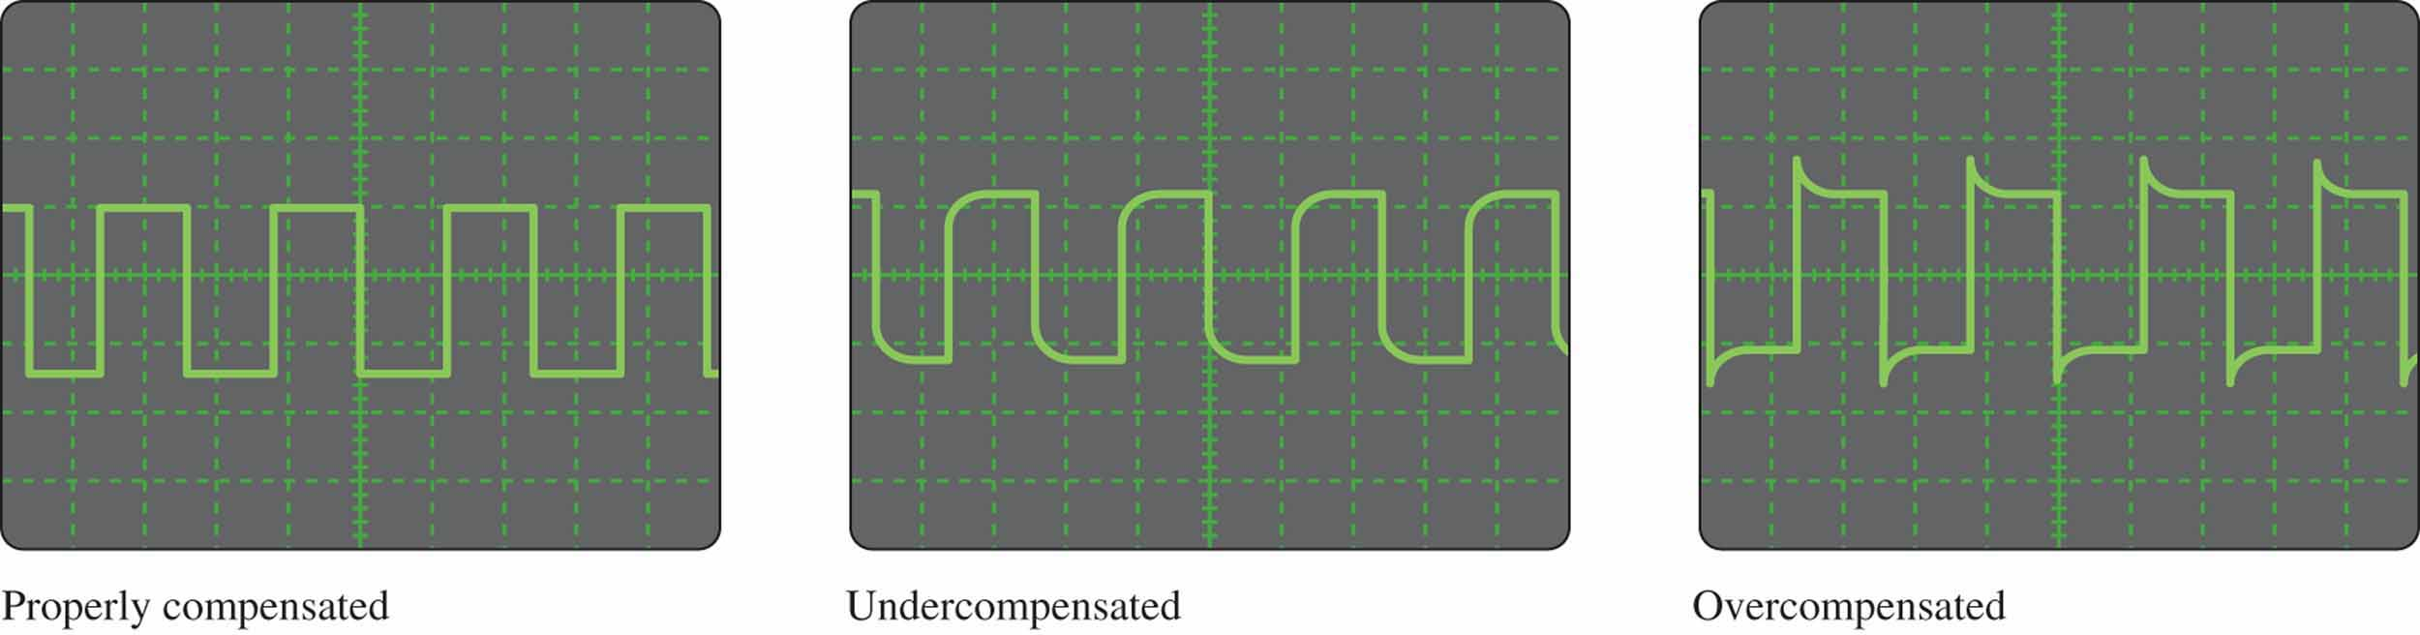
Chapter 1
Figure 1.25 Probe compensation conditions.

Slide 43
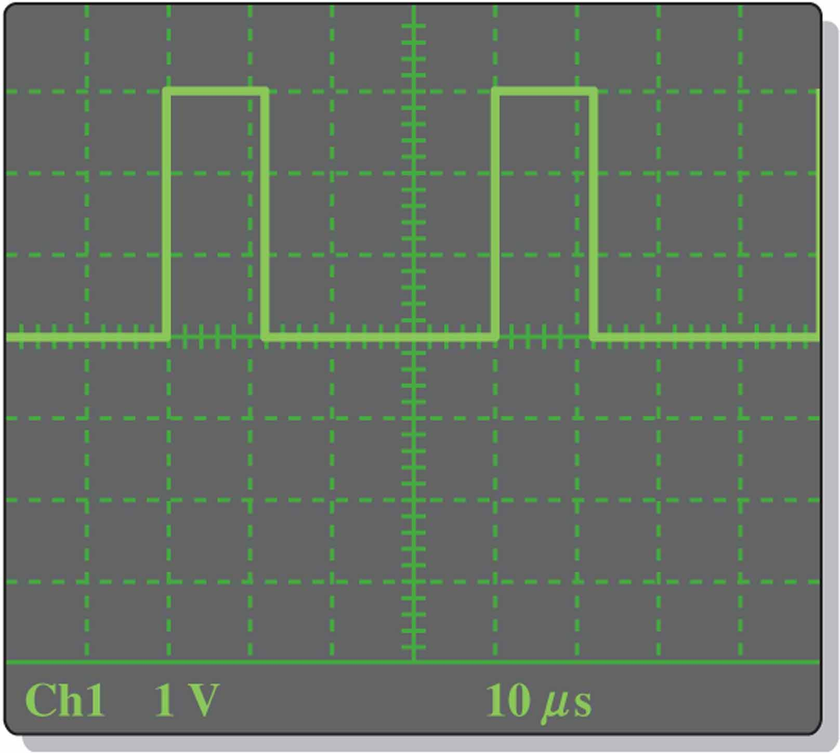
Chapter 1
Figure 1.25 Probe compensation conditions.

Slide 44
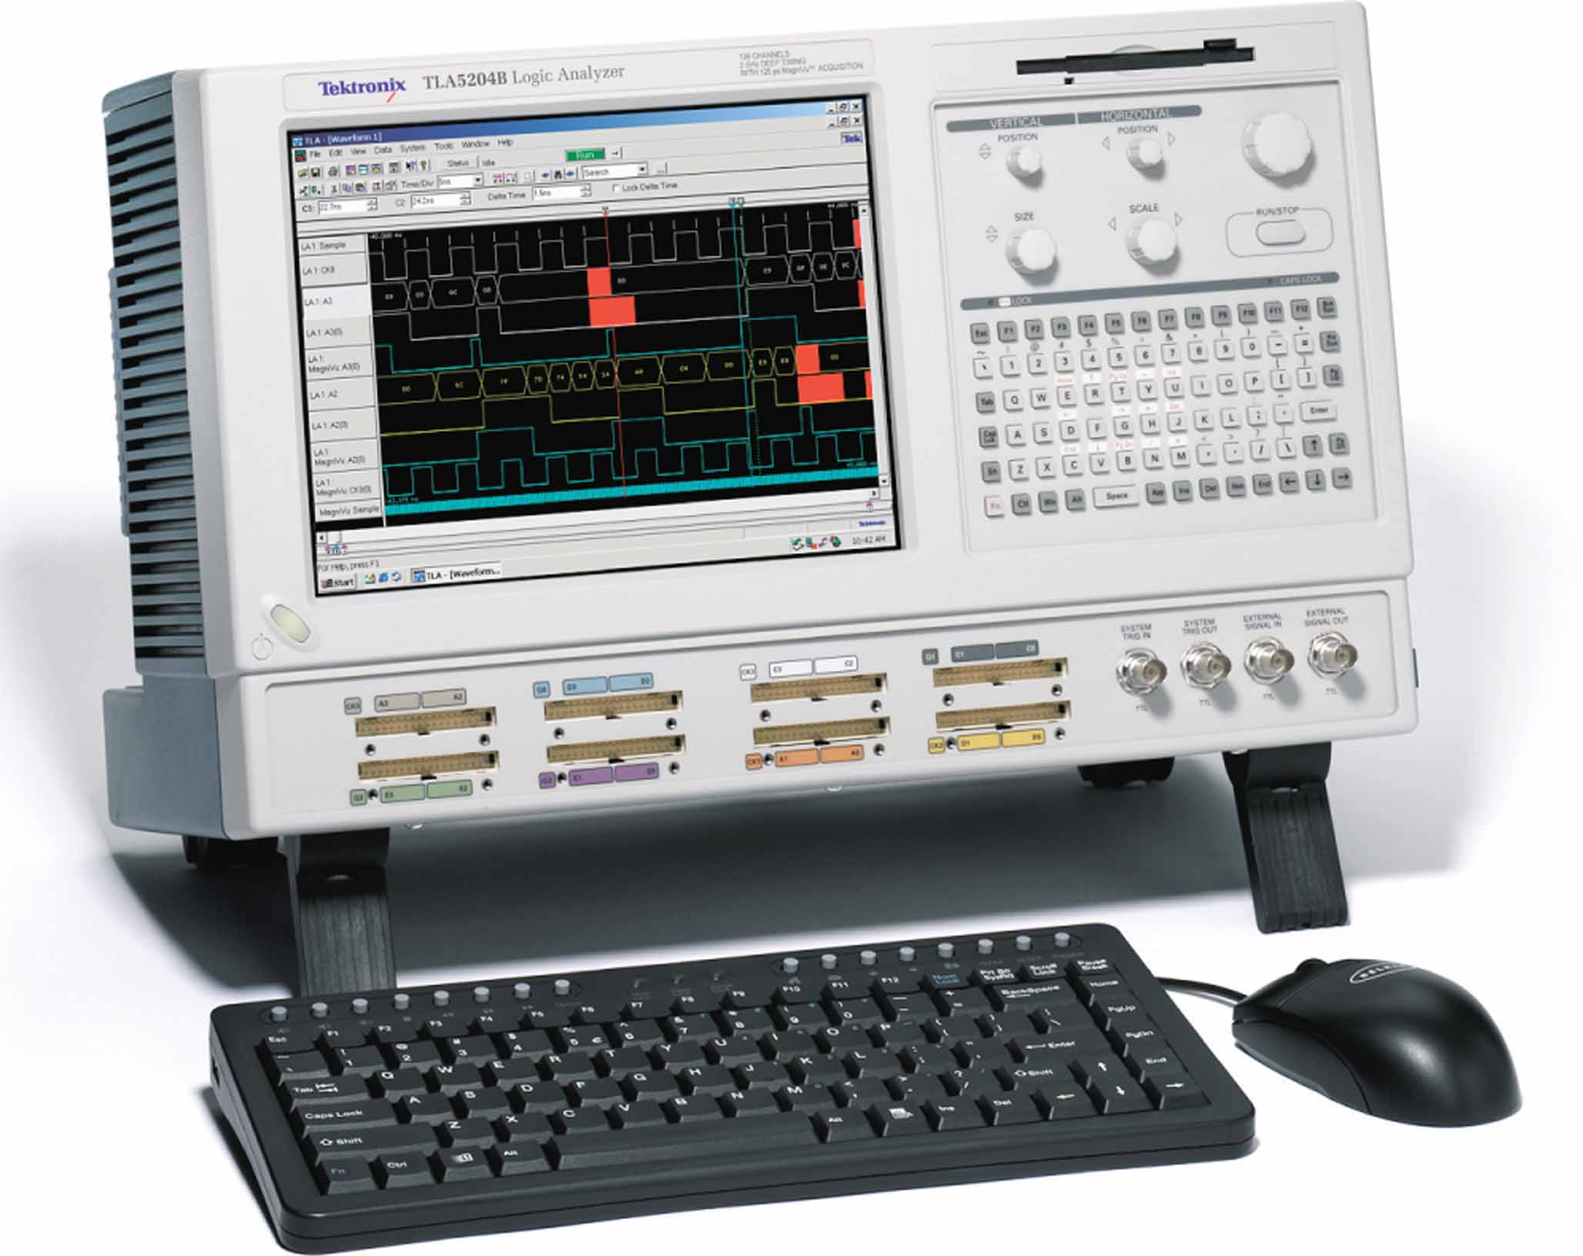
Chapter 1
Figure 1.25 Typical logic analyzer. Used with permission from Tektronix, Inc.

Slide 45
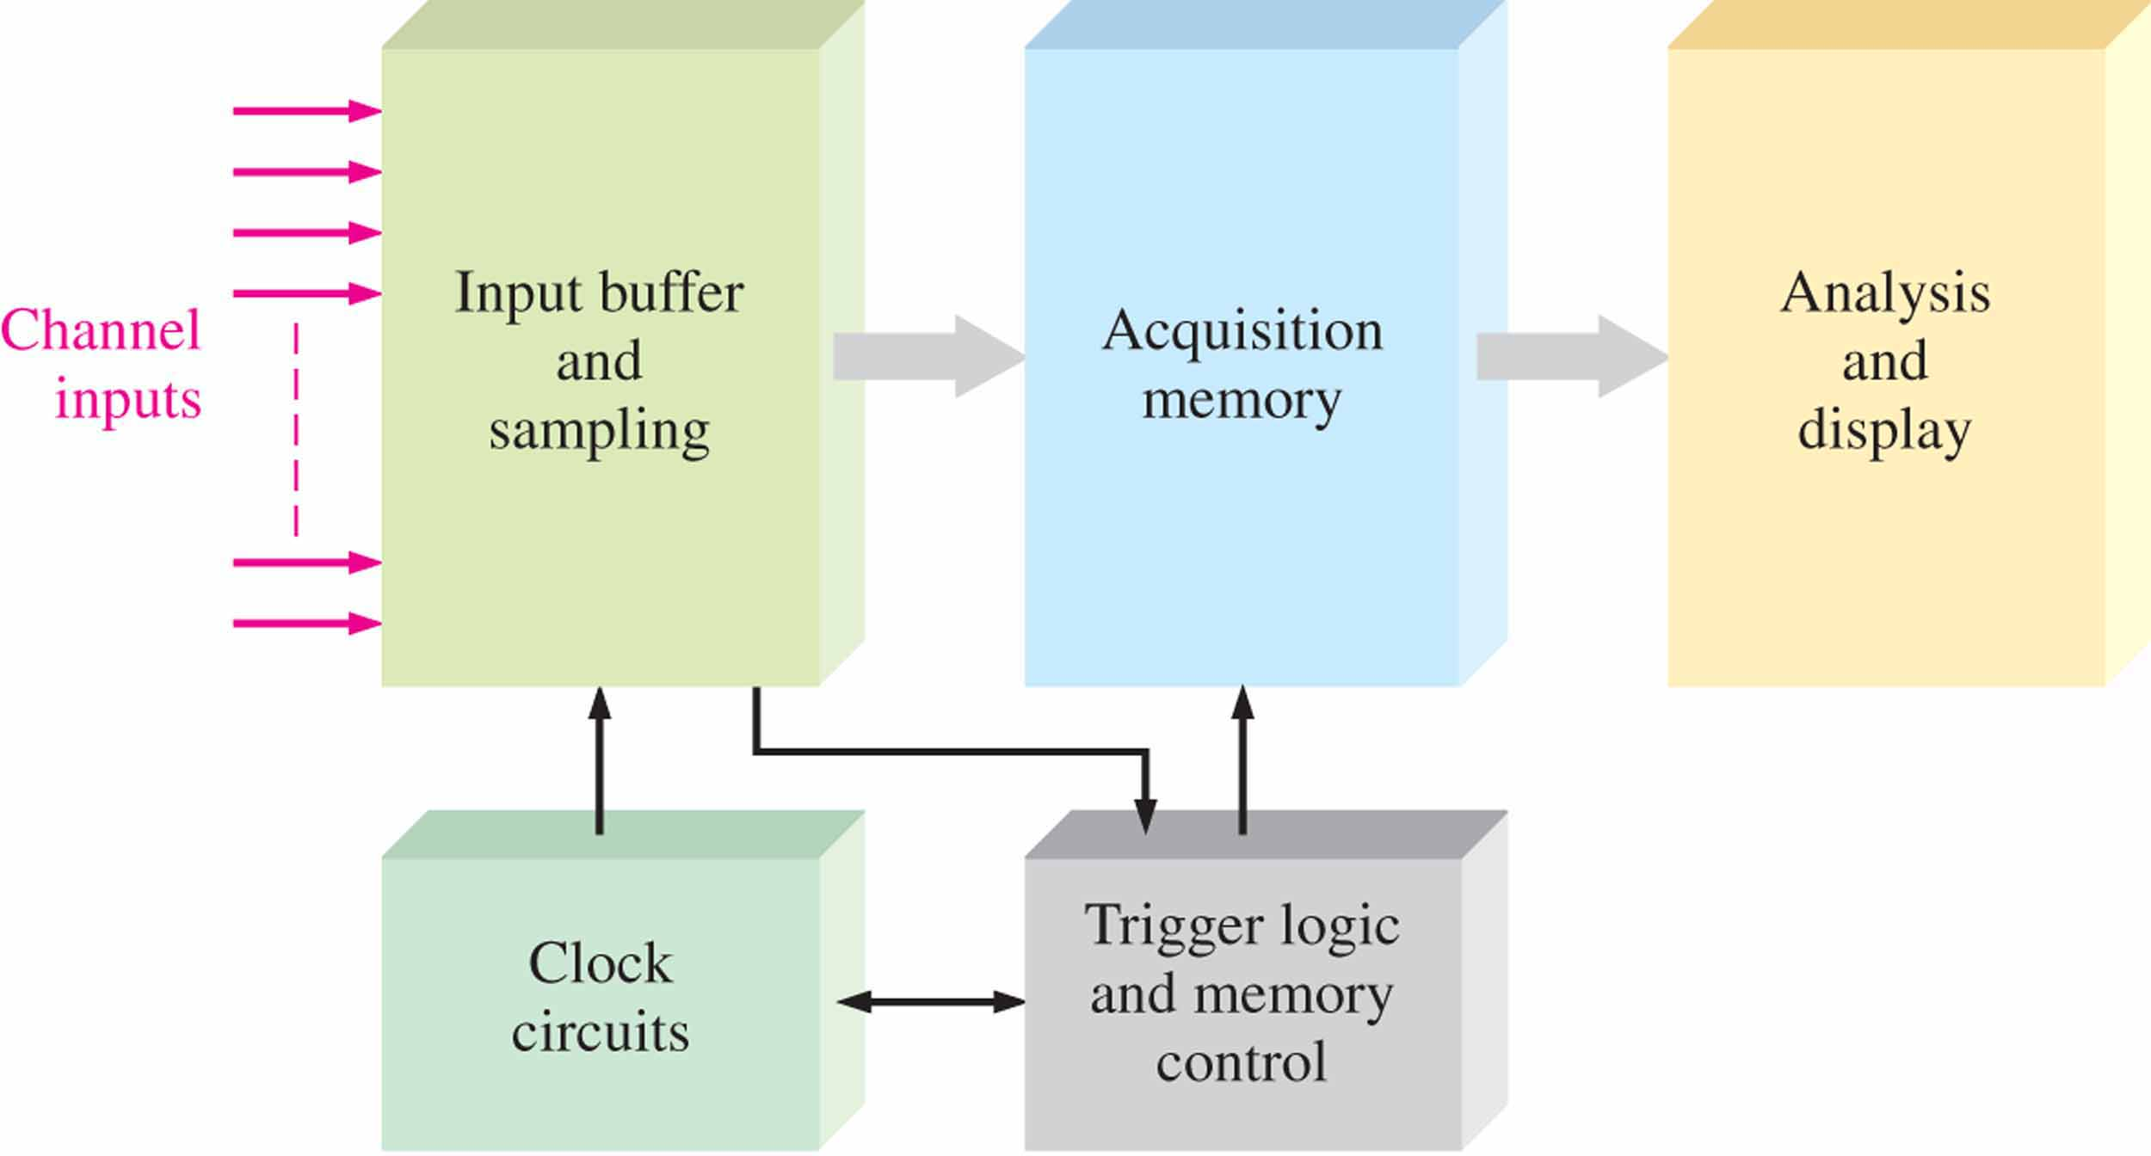
Chapter 1
Figure 1.25 Simplified block diagram of a logic analyzer.

Slide 46
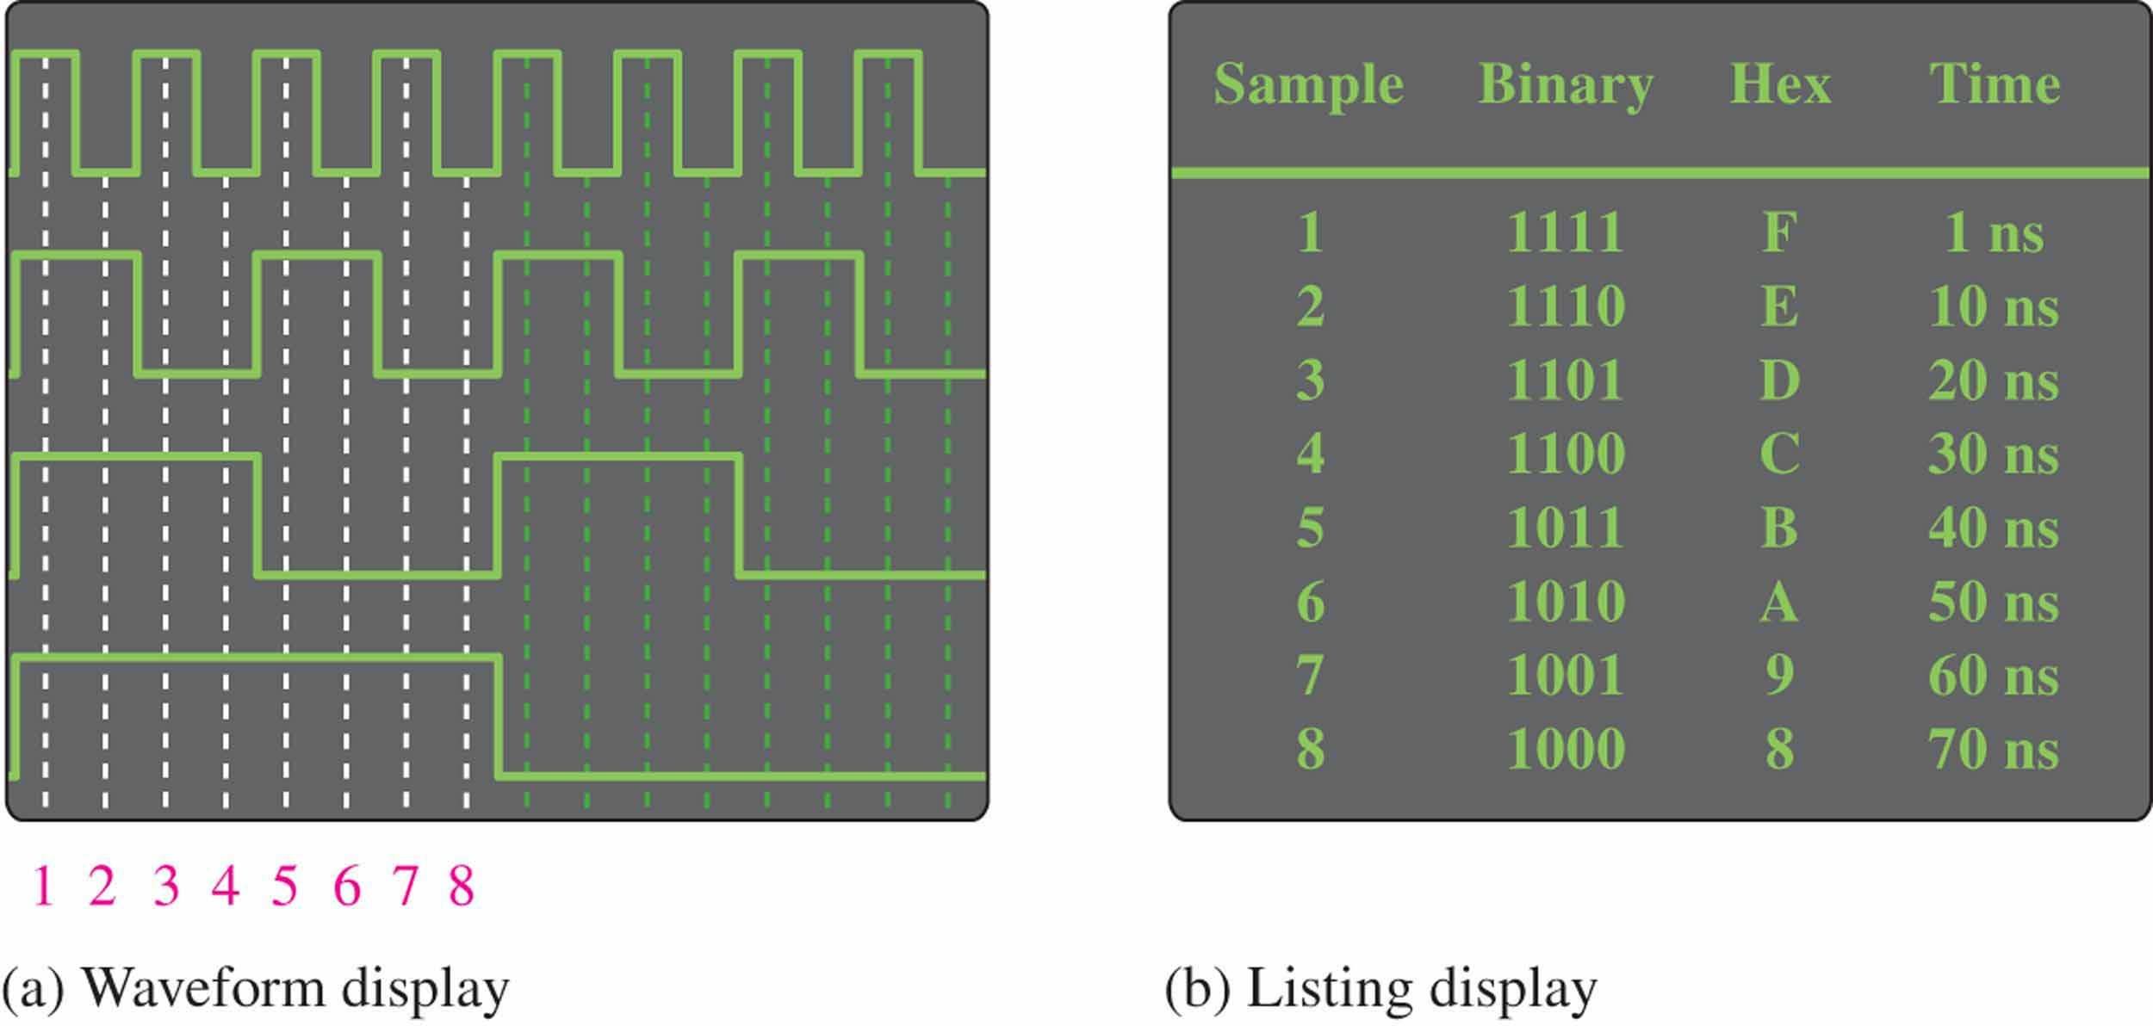
Chapter 1
Figure 1.25 Two logic analyzer display modes.

Slide 47
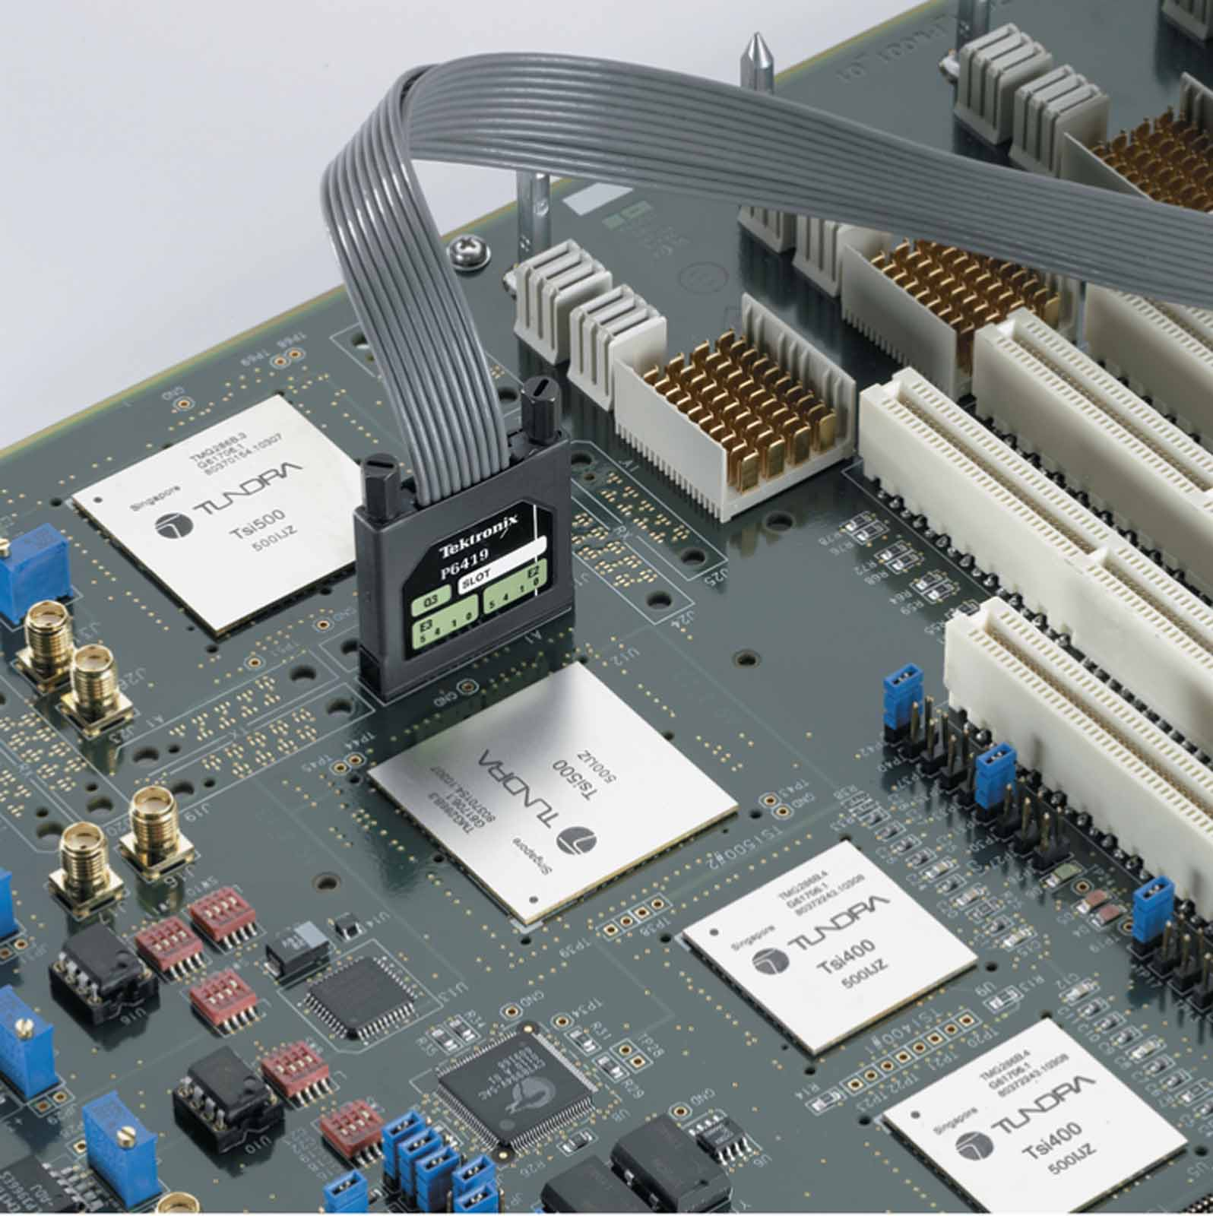
Chapter 1
Figure 1.25 A typical multichannel logic analyzer probe. Used with permission from Tektronix, Inc.

Slide 48
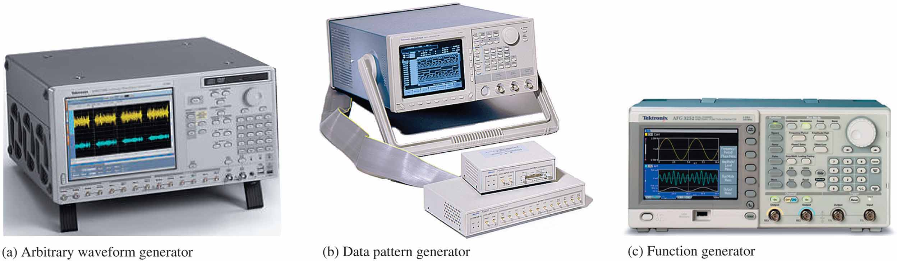
Chapter 1
Figure 1.25 Typical signal generators. Used with permission from Tektronix, Inc.

Slide 49
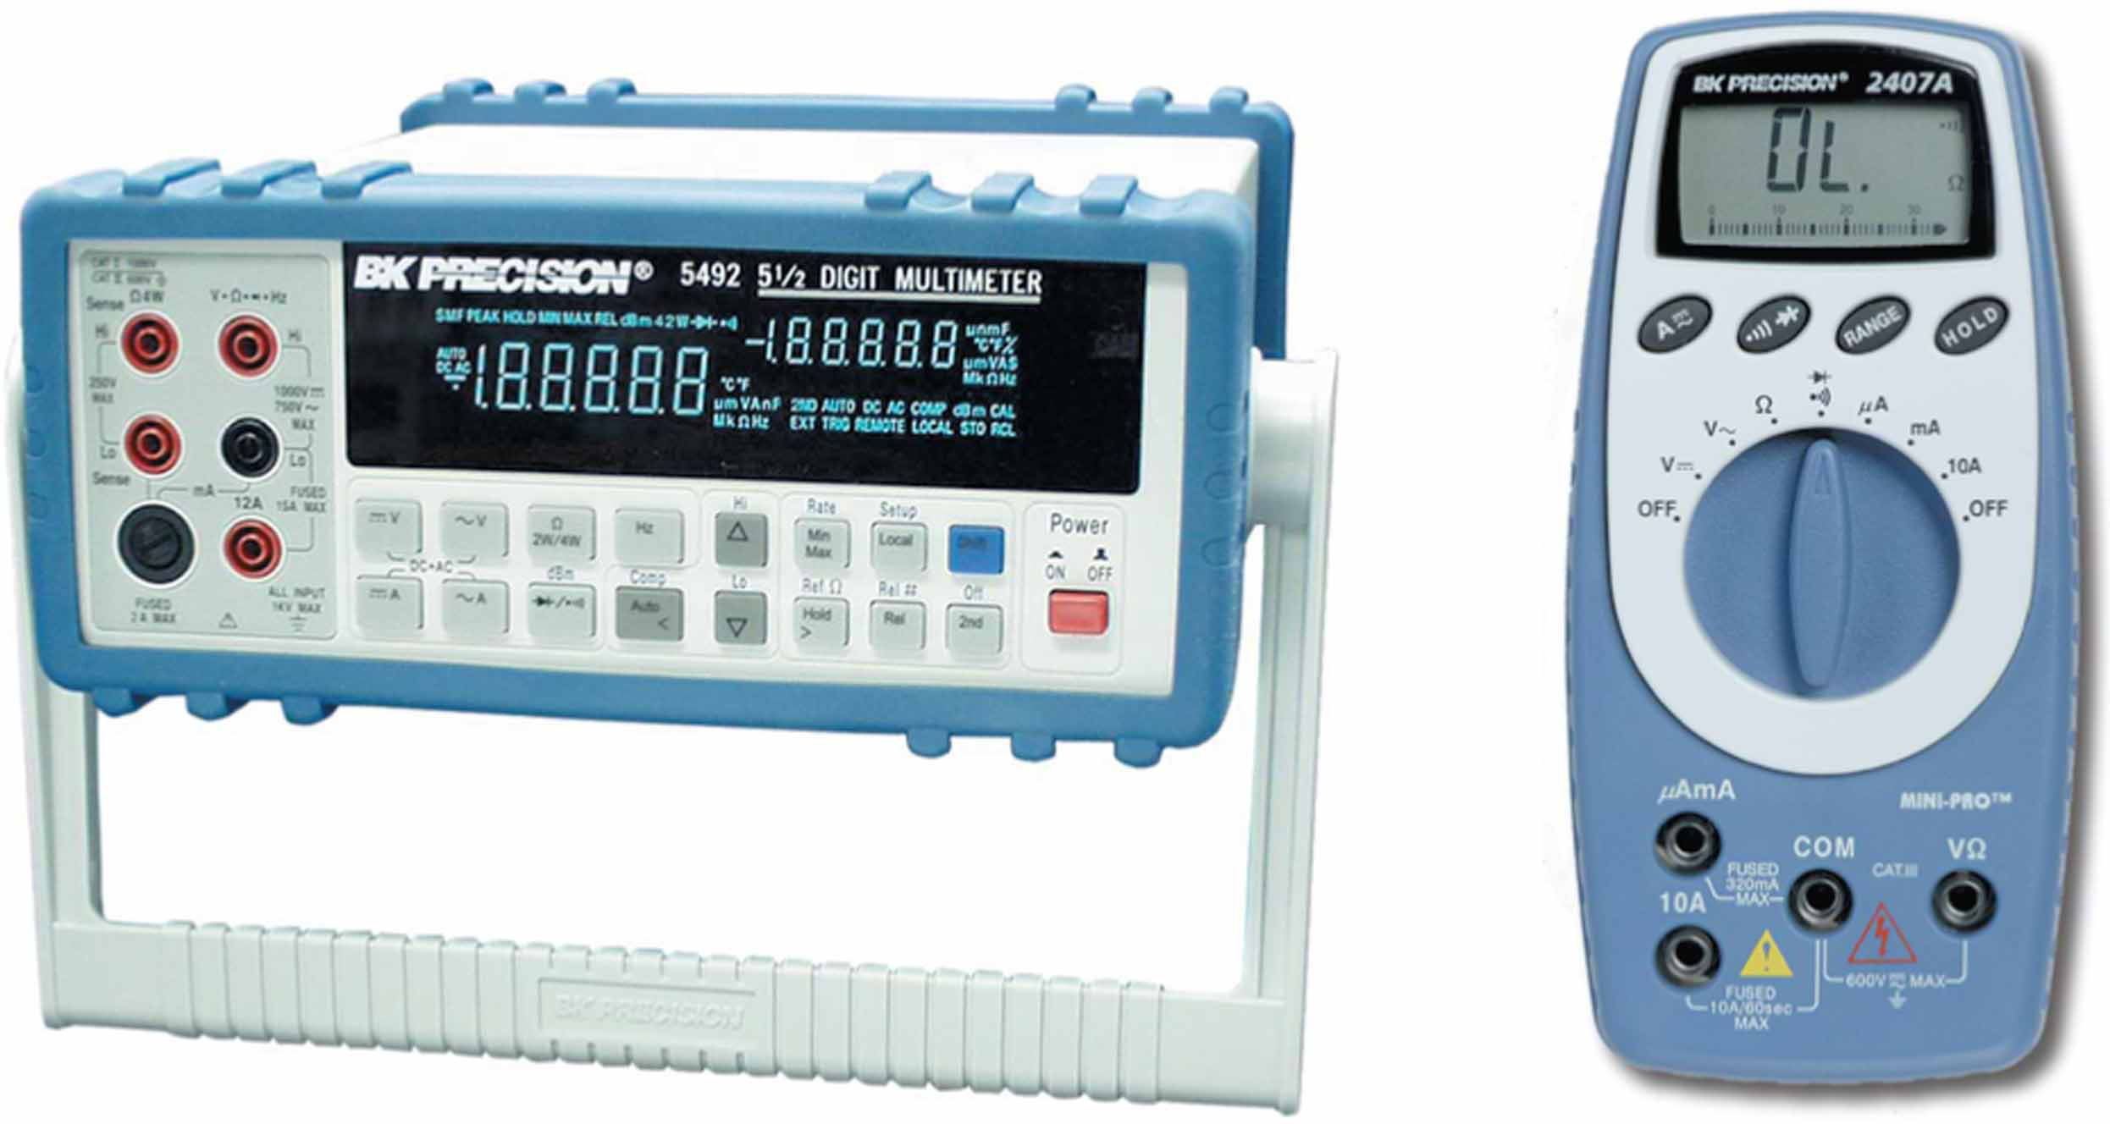
Chapter 1
Figure 1.25 Typical multimeter. Used with permission from Tektronix, Inc.

Slide 50
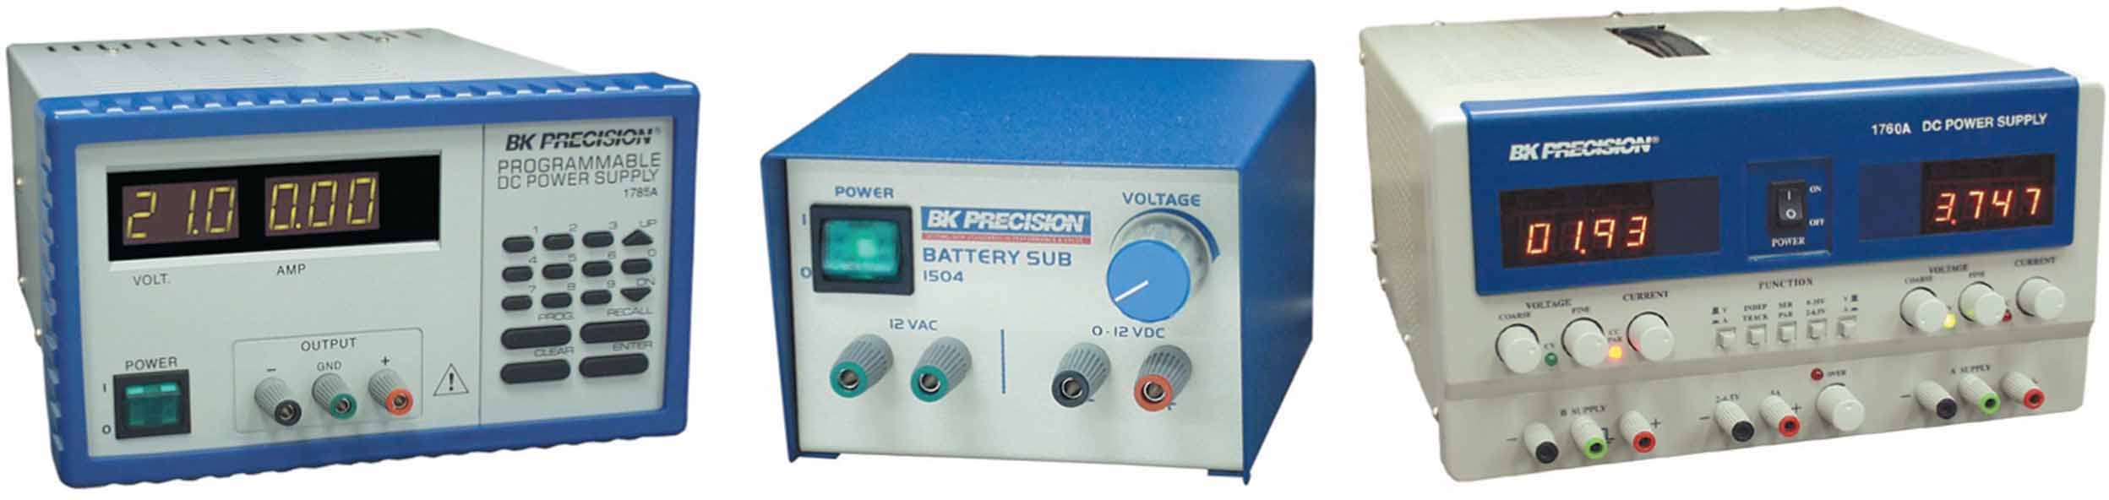
Chapter 1
Figure 1.26 Typical DC power supplies. Courtesy of B+K Precision.®

Slide 51
Homework
1.1节：1
1.2节：
5、6；
8-11（波形特征）；
12、13 （串行传输）

Slide 52

TO BE CONTINUED

